Slide 1
Brian Crume
E & B Paving, Inc.
Welcome to:
ASPHALT 101
AMERICA RIDES ON US

Slide 2
HMA Plant Operation

Slide 3
Basic Purpose Of HMA Plants
Produce quality asphalt mixture
Contains the desired proportions
Asphalt
Aggregate
Meets specifications.
Notes:
Regardless of the type of plant - the basic purpose is the same. It is as shown on this slide.

Slide 4
Drum Mixer Plant Typical Layout
Asphalt Storage
Aggregate Bins
Conveyor Belts
Dryer-Mixer
Burner
Storage Silo
Notes:
This is a typical layout for a Drum mixer plant.

Slide 5
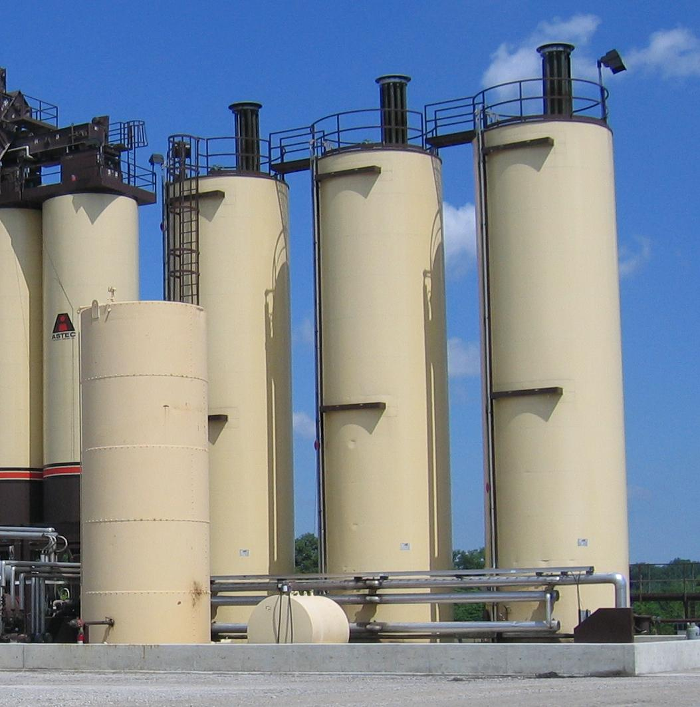
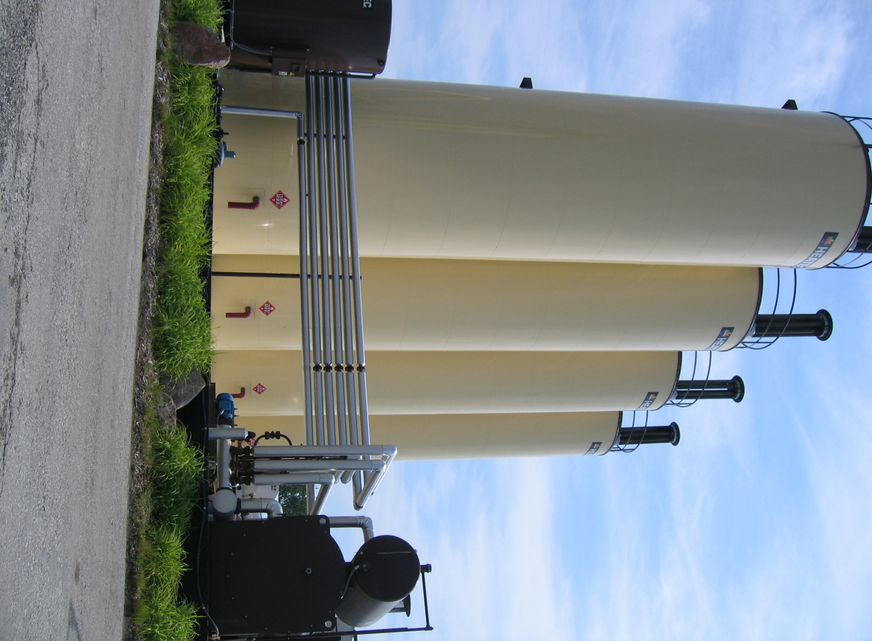
Asphalt Binder Storage Tanks

Slide 6
Aggregate Stockpile
Notes:
The stockpiles must be managed to prevent contamination.

Slide 7
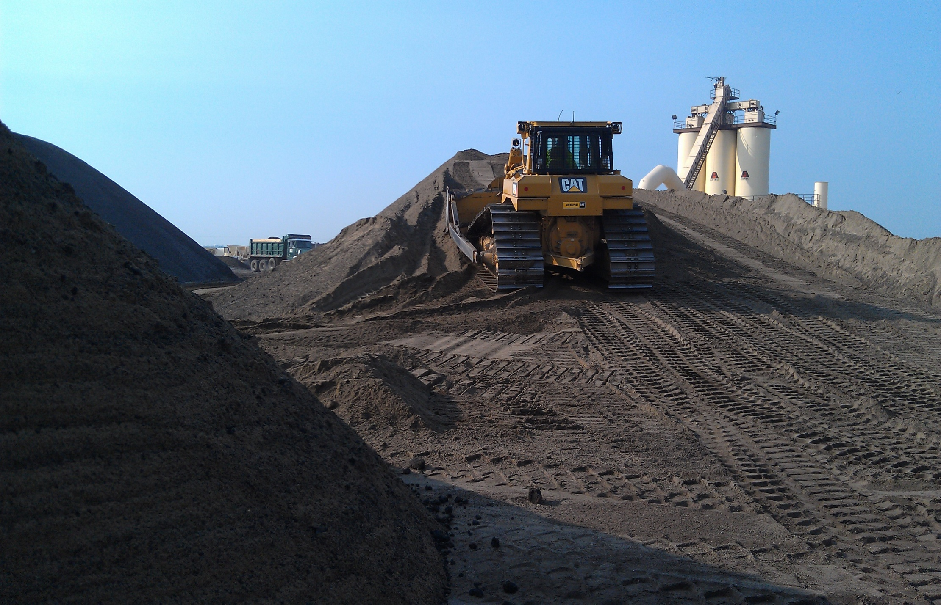
RAP Stockpile
Notes:
The stockpiles must be managed to prevent contamination.

Slide 8
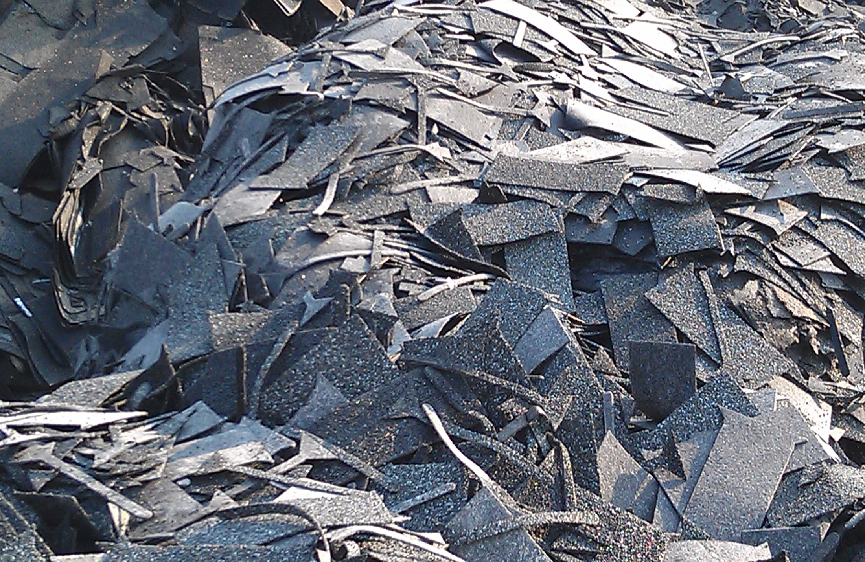
Unprocessed Shingles
Notes:
The stockpiles must be managed to prevent contamination.

Slide 9
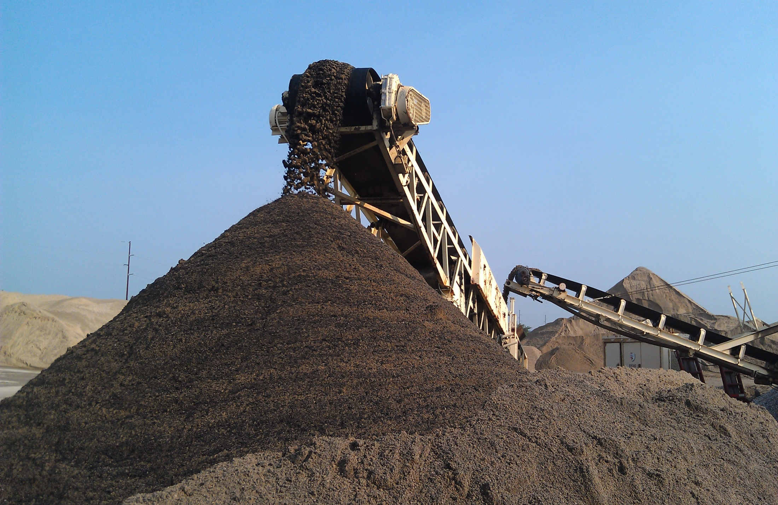
Processed Shingles
Notes:
The stockpiles must be managed to prevent contamination.

Slide 10
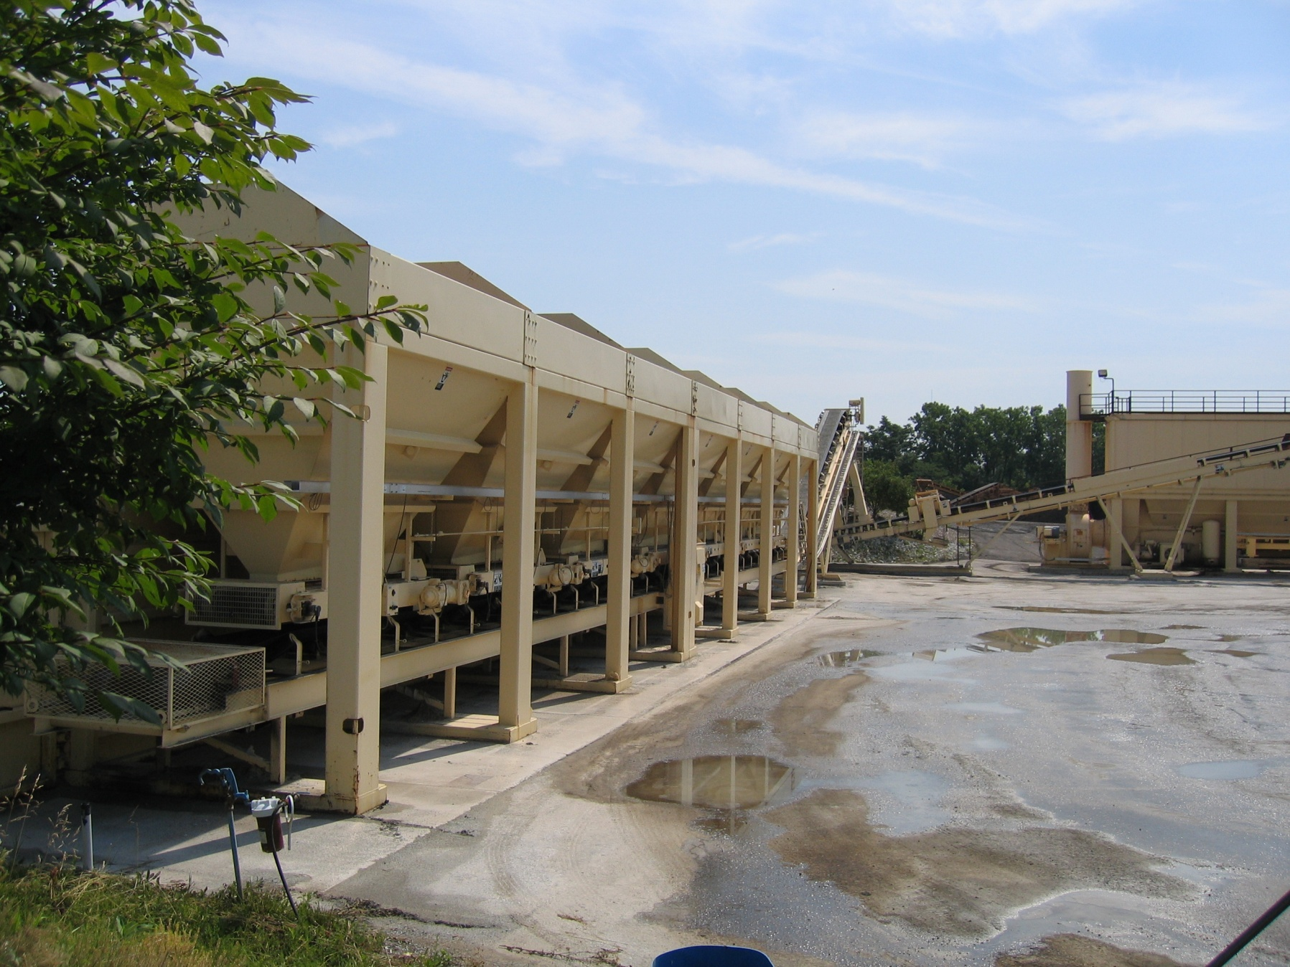
Cold Feed Bins
Notes:
After the aggregate is processed it is feed into cold feed bins where the exact proportions of the material are controlled.

Slide 11
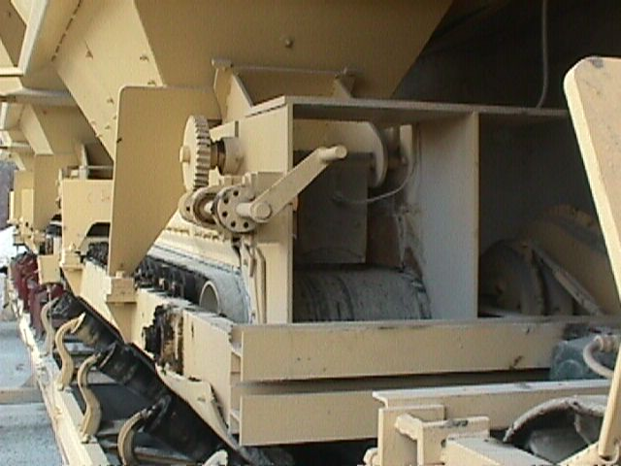

Slide 12
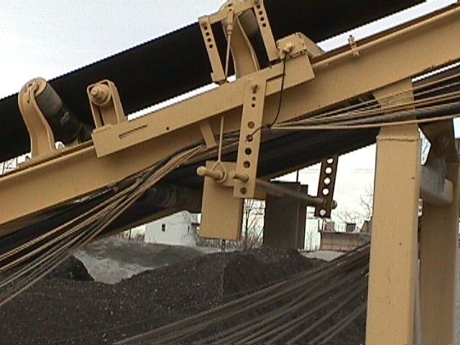
Weigh Bridge Control

Slide 13
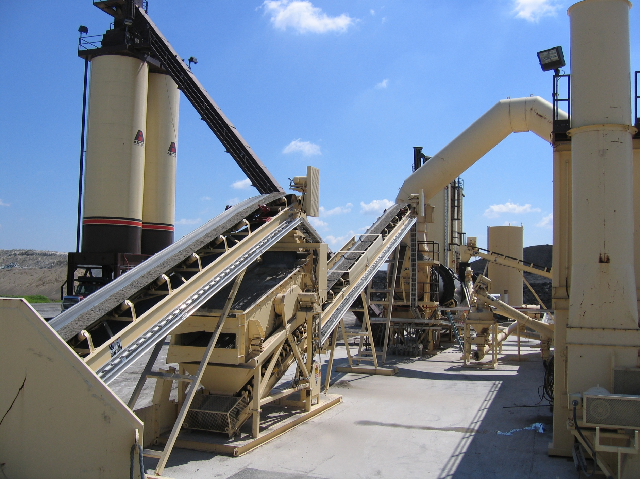
Drum Mix Plant
Weigh Bridge
Aggregate entry point into drum

Slide 14
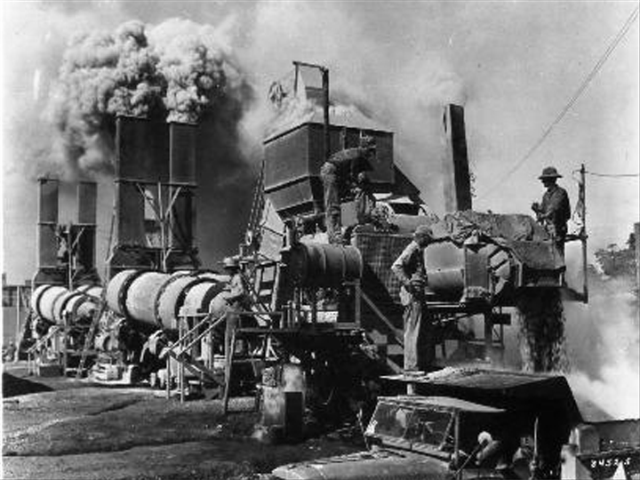
Dust Control??

Slide 15
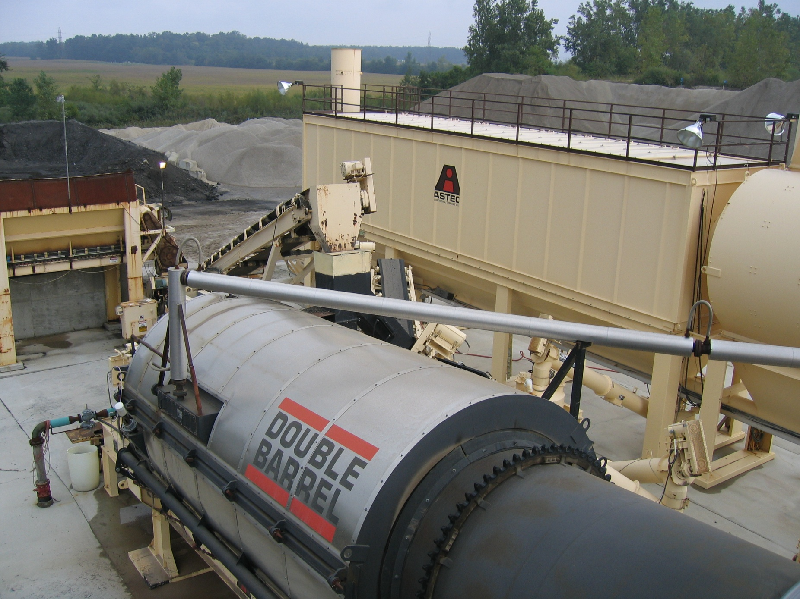
Bag house Dust Collector

Slide 16
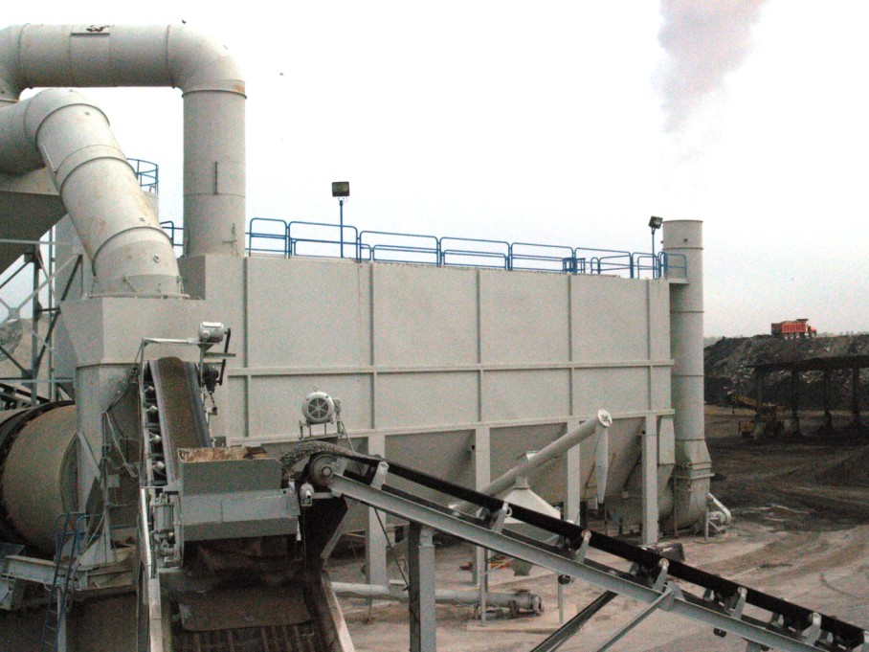
Bag house Dust Collector

Slide 17
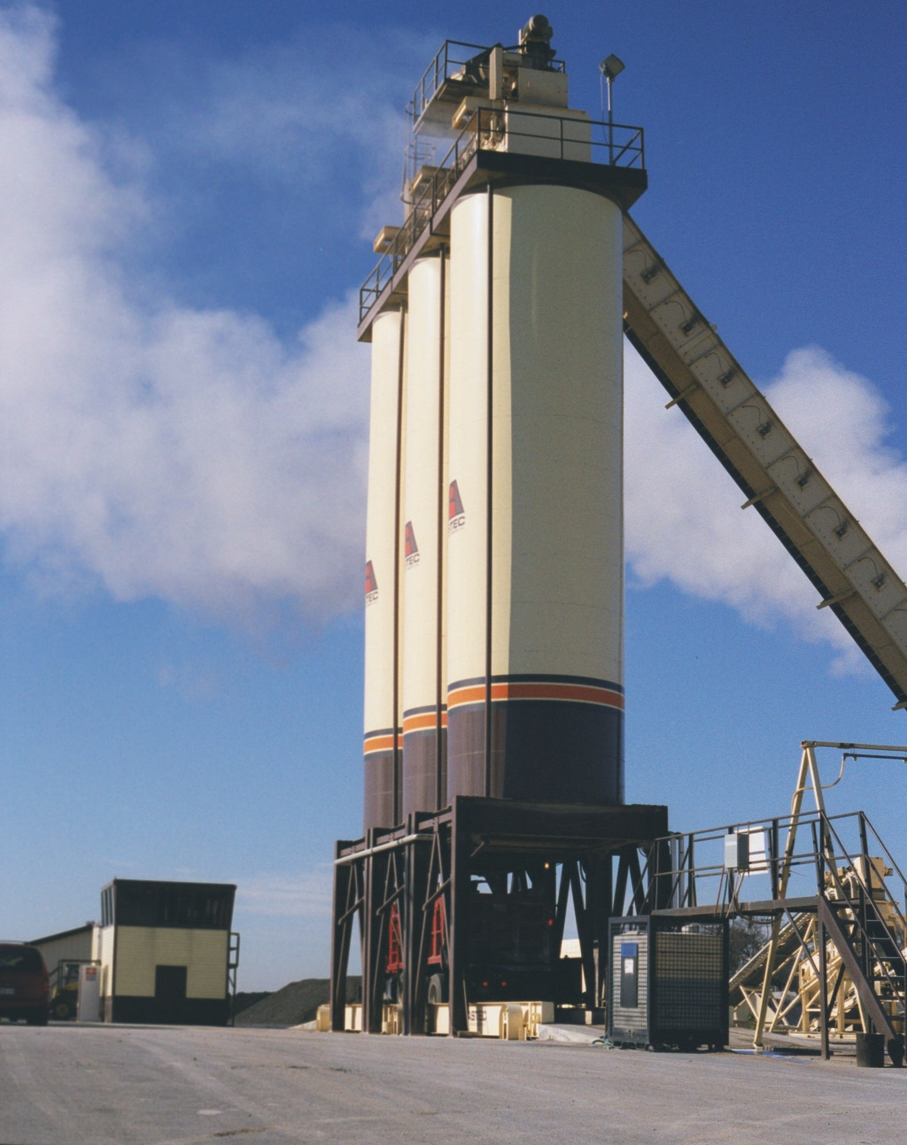
Storage Silos
Notes:
Typical surge silo.

Slide 18
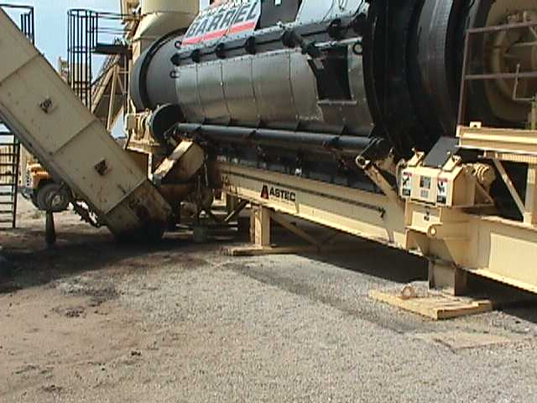
Mix Discharge

Slide 19
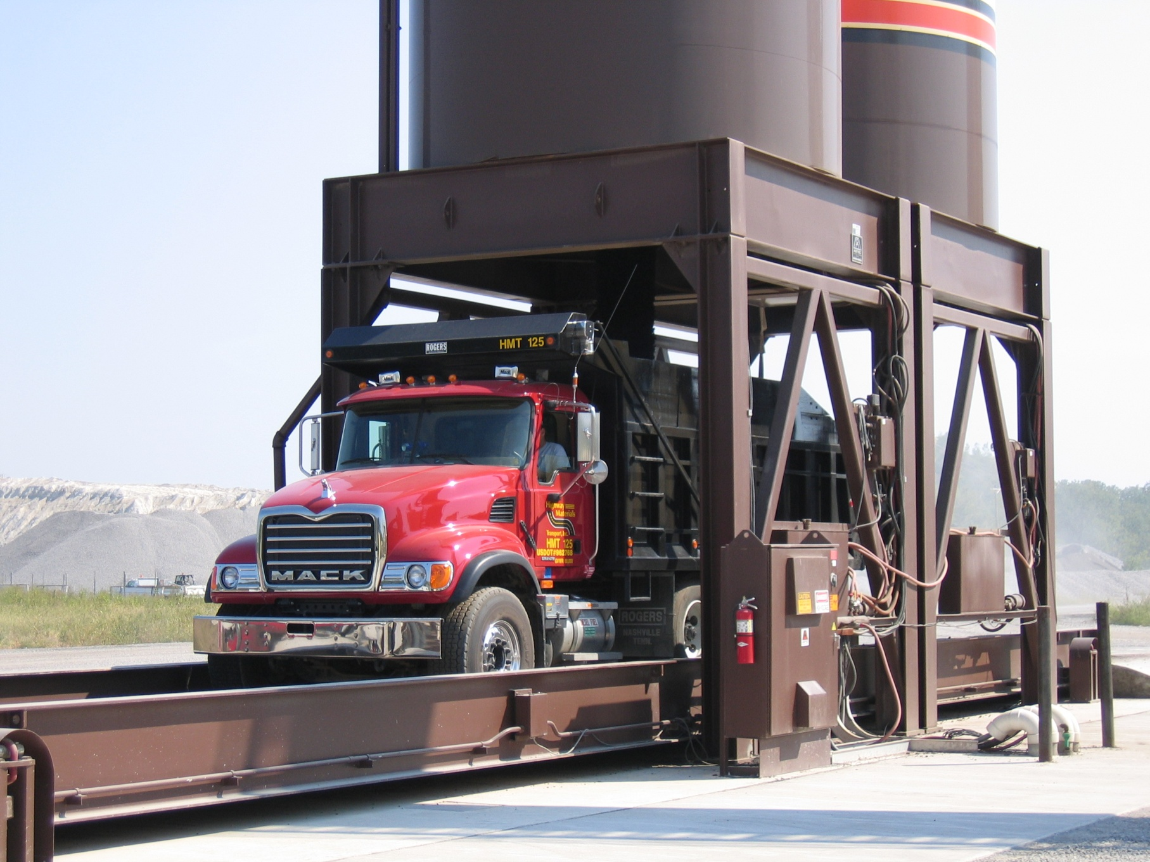
Scales

Slide 20
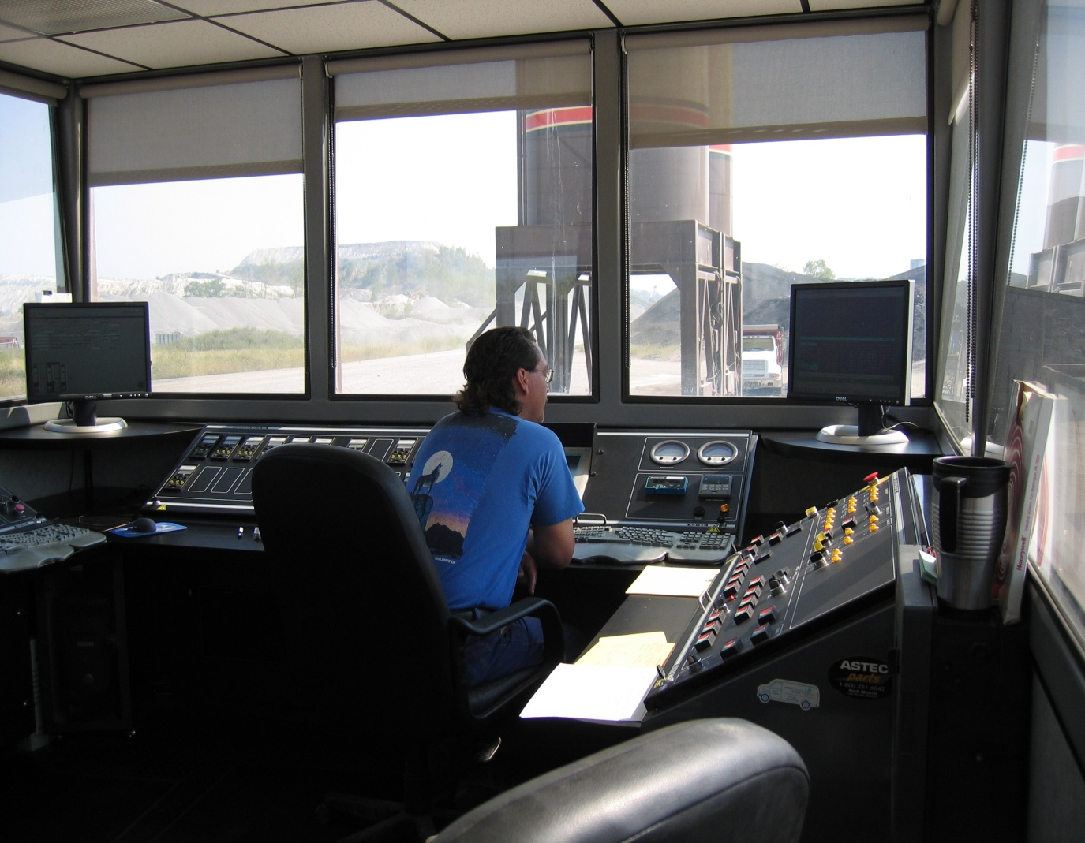
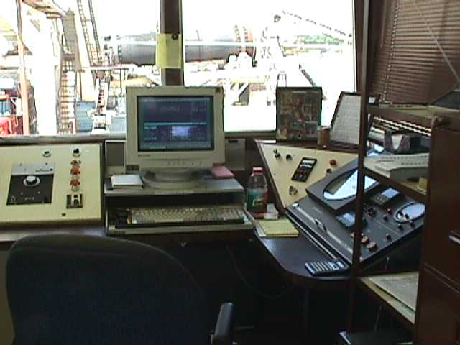
Plants are computer controlled
Notes:
Plants are computer controlled.

Slide 21
Next

Slide 22
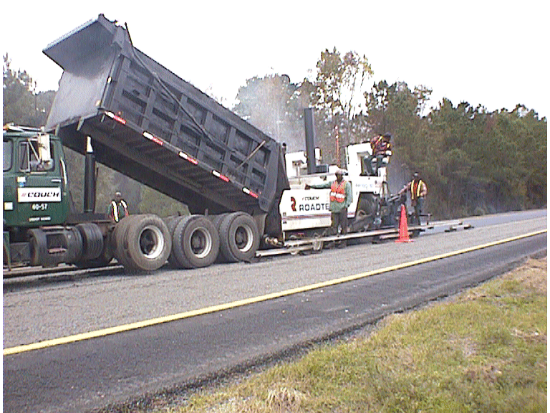
HMA PLACEMENT

Slide 23
To Be Covered
Hauling
Placement
Compaction
Notes:
This slide shows the four topics that will be covered in this block.

Slide 24
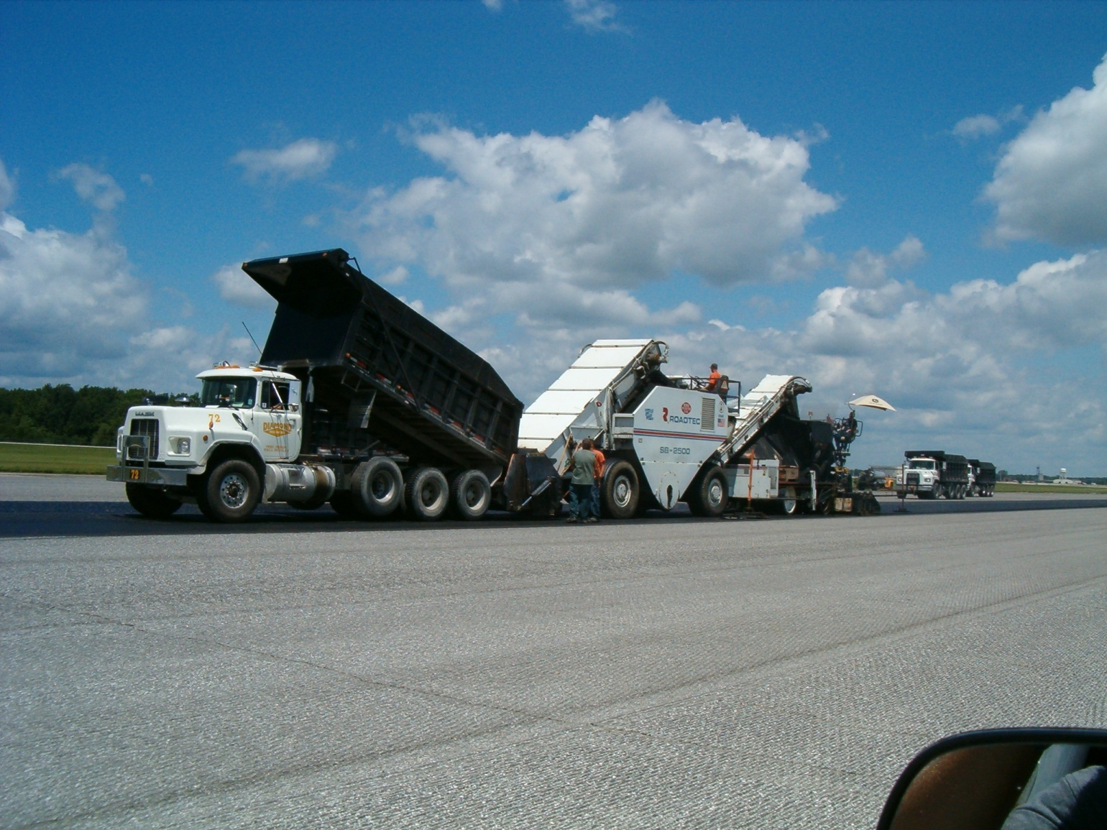
Tri Axle Dump Truck
Notes:
Trucks for use in hauling HMA come in many sizes. The key is that they have metal beds, be cleaned of foreign material and hardened asphalt. It is a practice within the industry to coat the beds with a release agent. For many years this release agent was diesel fuel - the diesel fuel will soften the asphalt binder and can result in soft spots in the pavement.
The number of trucks required depends on many factors: the production of the plant, the length of the haul, the type of traffic encountered and the expected time needed for unloading.
This is an end dump truck that loads directly into the paver. During delivery the driver must direct the truck squarely against the paver, and should stop the truck a few inches in front of the paver. The truck bed is slowly raised. When the mix is dumped to quickly segregation occurs.

Slide 25
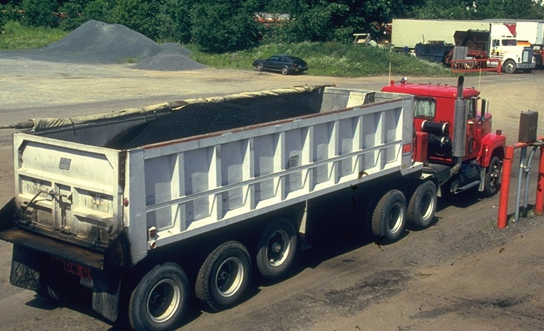
High Dump Semi-truck

Slide 26
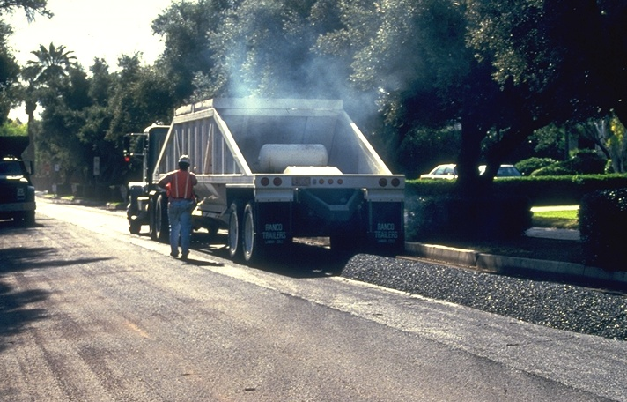
Belly Dump
Notes:
Bottom dump trucks can be used when a pick-up device is used to feed the windrow left by the truck into the paver hopper. It is essential that the windrow deposited by the truck be as uniform as possible. Windrowed material can cool below spreading and compacting temperatures in cool weather. This can be a major problem is the paver has a malfunction. To prevent excessive cooling of the mix in cool weather; the limit of windrow should be no more than one truck load ahead of the pick up machine.

Slide 27
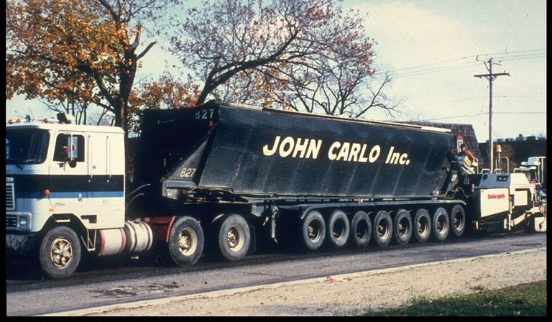
Multi-WHEELED Conveyor Feed
Notes:
This a truck used in Michigan. The material is feed into the paver from a conveyor belt at the bottom of the truck. NOTE- the number of wheels.

Slide 28
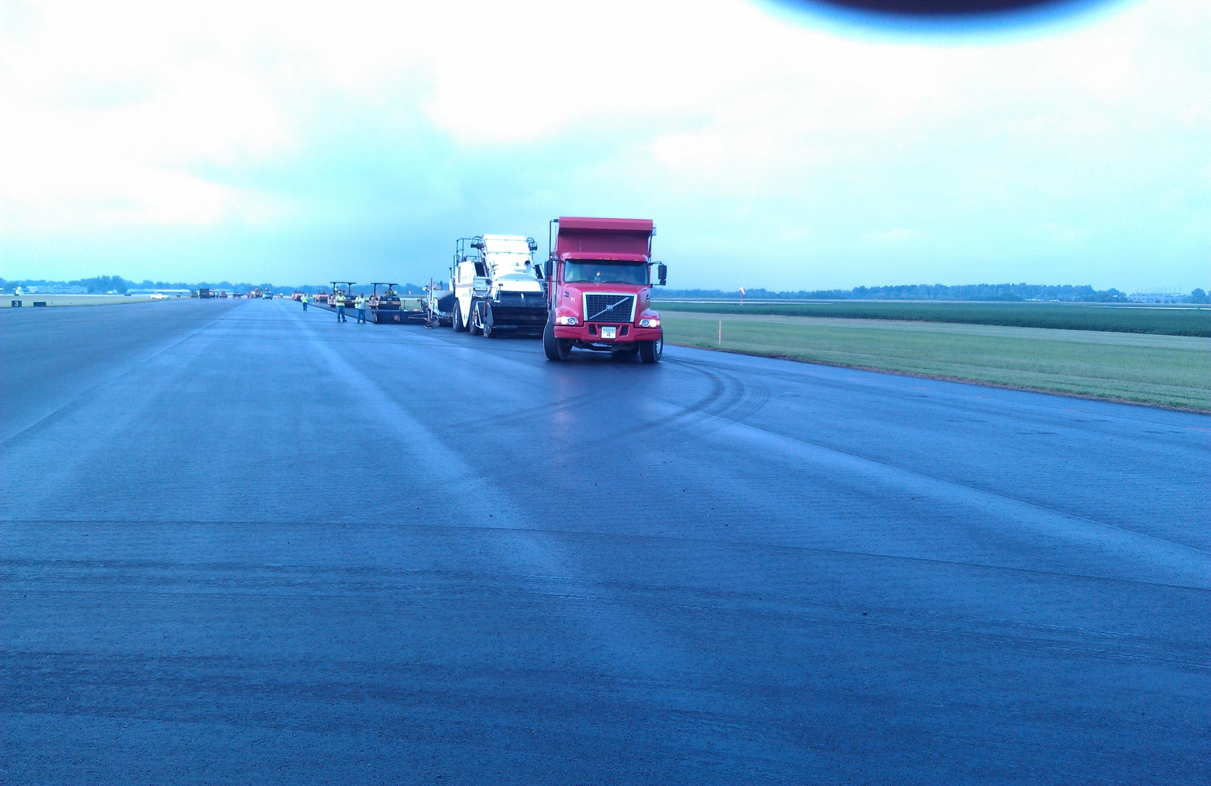
Correct Tack on Asphalt

Slide 29
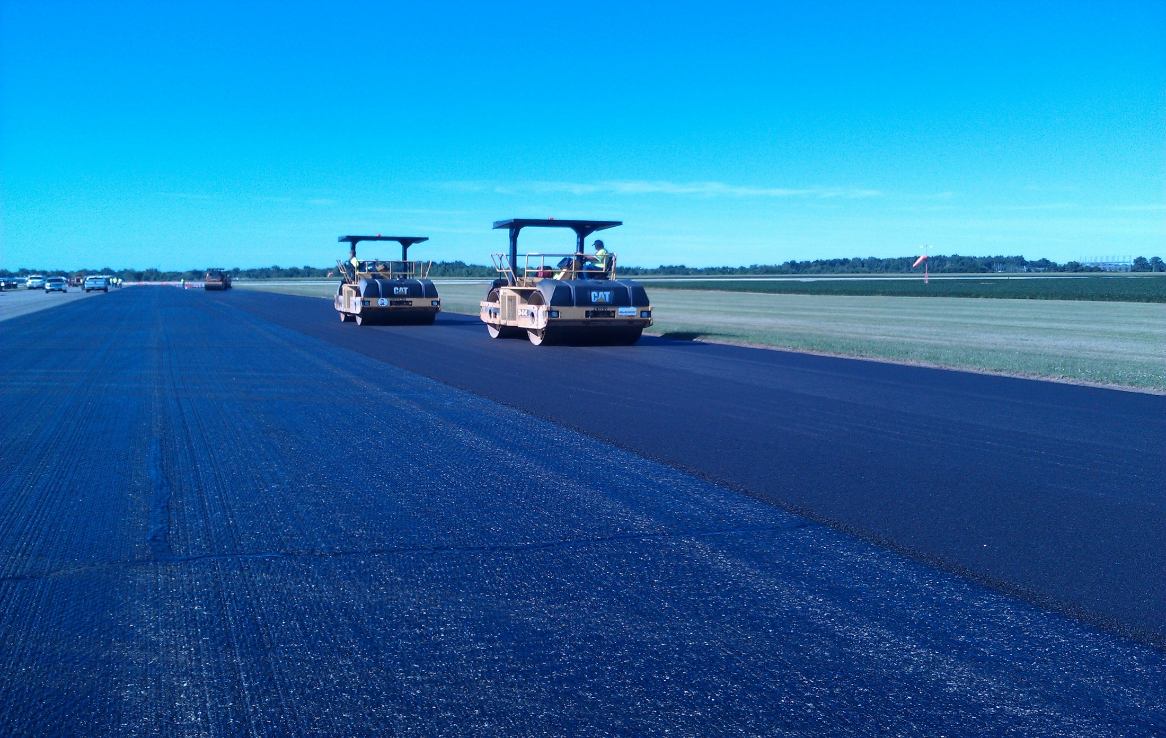
Correct Tack on Milled Asphalt

Slide 30
Incorrect Tack on Asphalt

Slide 31
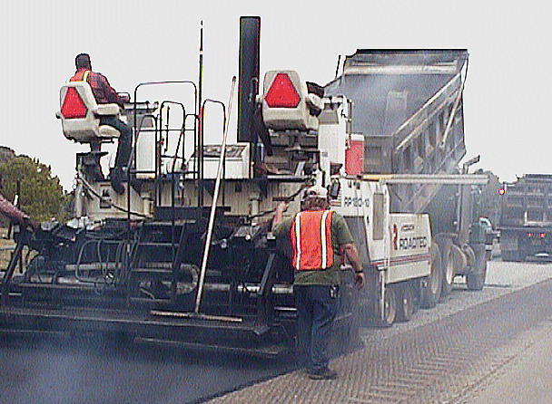
Self Propelled Paver
Notes:
The mix is placed with a self-propelled paver. It can be done with a motor grader; but, that is seldom done. The purpose of the paver is to place the HMA to the desired width and thickness and to produce a satisfactory mat texture. The mix is usually placed at 3 times the thickness of the nominal aggregate size.

Slide 32
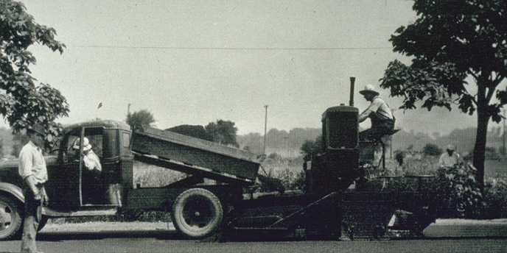
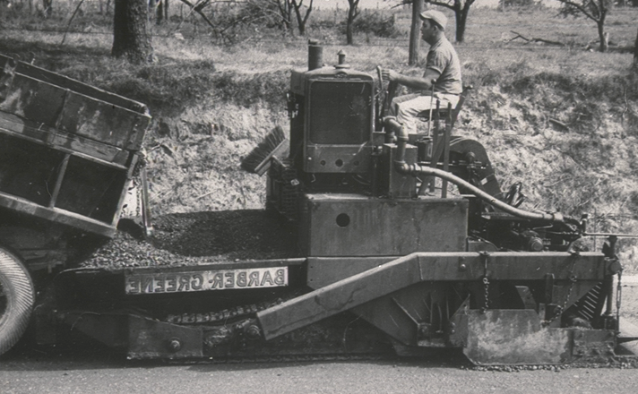
Self Propelled Paving Machine
THE BASIC PRINCIPLE HAS NOT CHANGED MUCH
Notes:
The basic principle behind the pavers has not changed much since the 1930s.

Slide 33
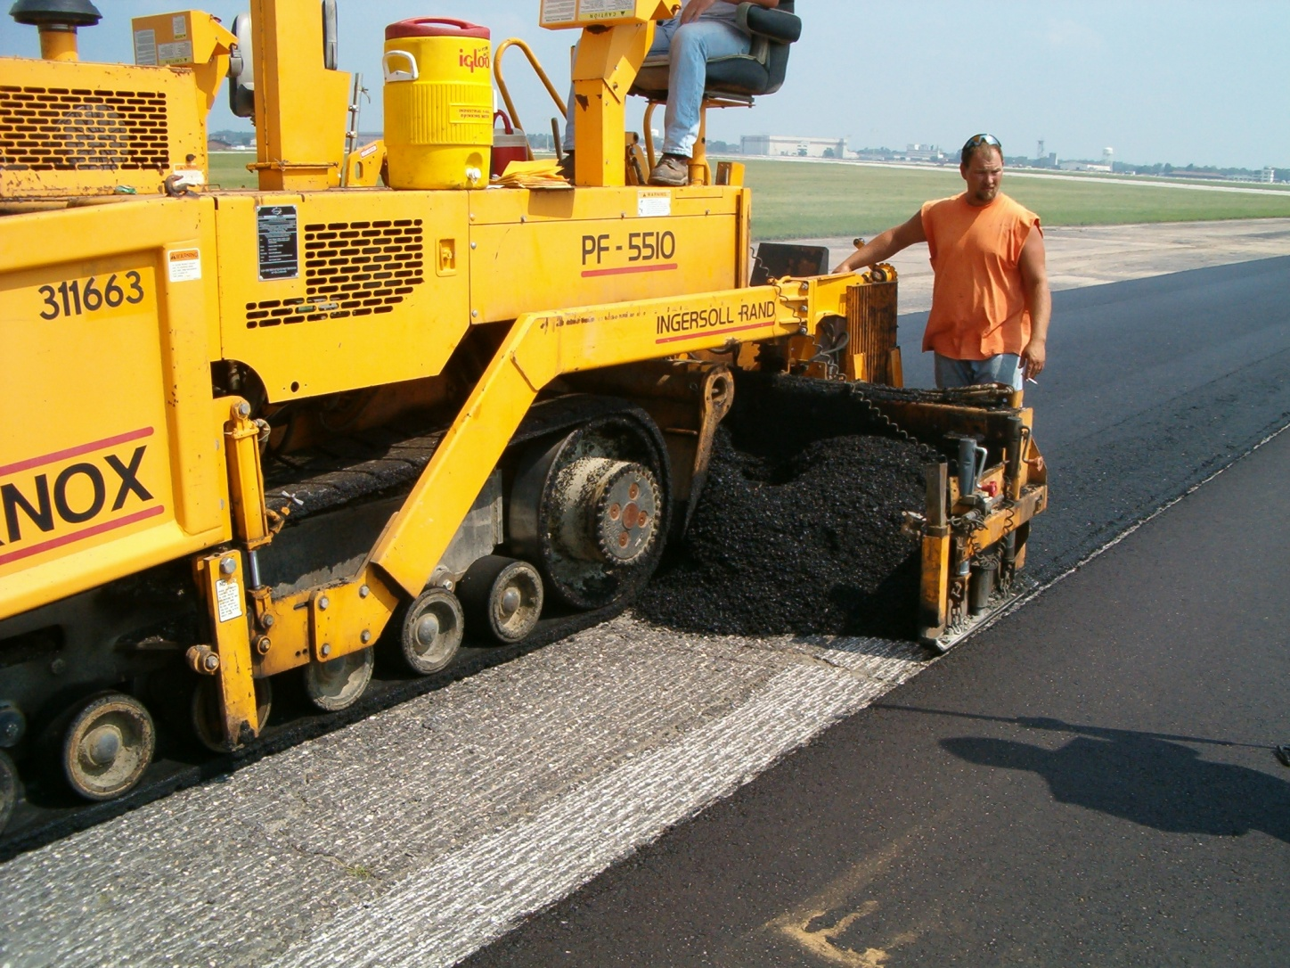
Self Propelled Paving Machine
Notes:
This picture identifies each of the components of the paver:
1. The tractor unit receives the mix from the haul trucks, carries the material back to the spreading screws and distributes the mix across the width of the screed.
2. The hopper is used to temporarily hold the mix.

Slide 34
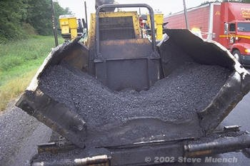
Paver Hopper

Slide 35
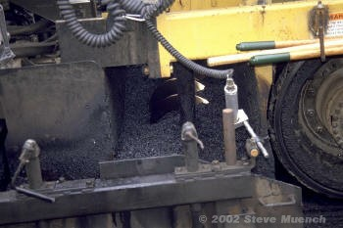
Auger & Screed Extension

Slide 36
Screed Unit
Notes:
The screed unit is towed by the tractor unit. It establishes the thickness of the asphalt layer and provides the initial texture to the new surface. In addition, the screed imparts some level of density to the material being placed through the vibratory action of the screed or tamping bars.
The principle of the free-floating paver screed was developed in the early 1930s. That concept allows the paver screed, which is attached to the tractor unit at only one point on each side of the machine to average out changes in grade that are experienced by the wheelbase of the tractor unit.

Slide 37
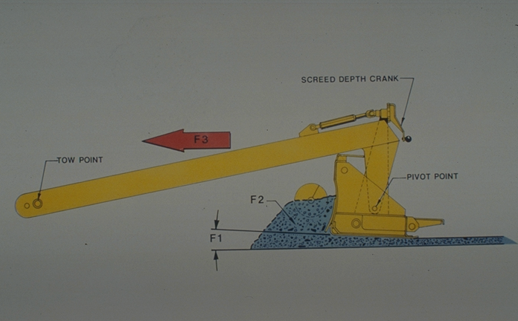
Forces On Screed
Notes:
The screed unit is attached to the tractor unit at only one point on each side of the paver. This point is called the tow point. It is a pin-type connection that allows the leveling arms of the screed to rotate or pivot around that point. The position of the tow points can be altered by raising or lowering the rods on which the pull points are mounted.
The screed assembly is shown here. There are two primary forces acting on the paver screed as the paver places the mix. The first force is the F3 - it varies as the speed of the tractor increases or decreases.
The second force on the screed is the head of the material pushing against the screed. As the amount of material in the augar chamber that pushes against the screed changes, the net forces acting on the screed also changes. As the forces acting on the screed change the screed unit must come to a new angle of attack in order to compensate for the change in force acting on it.
The forces on the screed unit must be in equilibrium for the screed to remain at a constant angle of attack as it is towed by the tractor unit. When a change occurs in one force, the screed will rise or fall and will change the thickness of the mat.

Slide 38
ONE OF THE ESSENTIALS FOR A CONSISTENT AND HIGH QUALITY HOT MIX ASPHALT PAVEMENT IS TO PROVIDE FOR A CONTINUOUS OPERATION

Slide 39
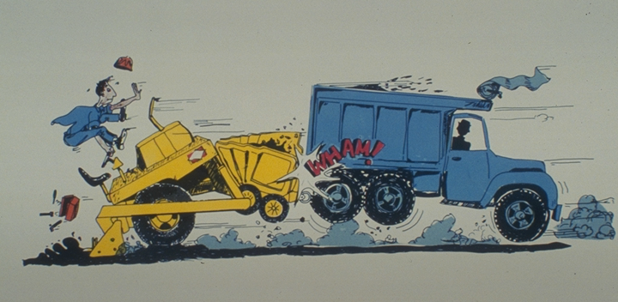

Slide 40
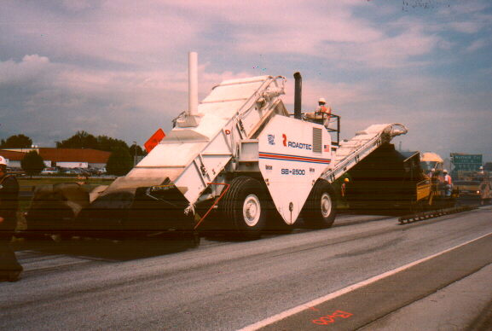
Material Transfer Device
Notes:
This is a material transfer device. It’s primary purpose is to keep the operation flowing smoothly.

Slide 41
COMPACTION
GOOD COMPACTION LEADS TO GOOD PERFORMANCE
Notes:
Compaction is the single most important factor that affects the ultimate performance of an HMA pavement.

Slide 42
Reason For Compaction
To prevent further compaction
To provide shear strength or resistance to rutting
To ensure the mixture is waterproof
To prevent excessive oxidation of the asphalt binder

Slide 43
Durability vs Air Voids
Cohesion
Stability
Zone of Highest Durability
Flushing
Raveling
0
% Air Voids
Notes:
The goal is 4 to 7% air voids on the roadway.

Slide 44
Factors Affecting Compaction
Mix Properties
Aggregate
Asphalt
Mix Temperature
Layer Thickness
Environmental Factors
Rollers
Notes:
A coarse harsh mix is difficult to compact - a sandy mix is easy to compact.
A stiff modified asphalt is tougher to compact than a soft low viscosity asphalt. Also a increase in the asphalt content makes the mix easier to compact.
The temperature of the mix directly relates to the viscosity of the binder. Thus, the higher temperature the softer the asphalt.
The old rule of thumb was twice the maximum aggregate size for layer thickness. The new rule of thumb is that the layer thickness should be three times the nominal aggregate size.
It is harder to compact a mix on a cold wet day than on a warm sunny day.
The type, size and number of rollers significantly affects the compaction operation.

Slide 45
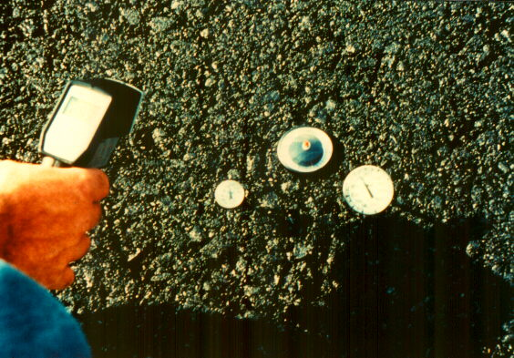
Temperature is critical
Notes:
One of the most important factors is the mat temperature. Too cold and the mix cannot be compacted - too hot and the mix will not support the rollers.

Slide 46
Rollers
Vibratory
Pneumatic-tired
Steel wheeled tandem rollers

Slide 47
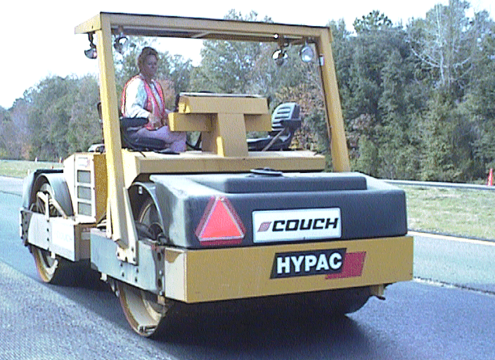
Vibratory Roller
Notes:
Vibratory rollers come in a variety of configurations. Single drum and double drum as shown here. These rollers can be operated in any one of three modes: static (with the vibrators off), with one drum vibrating and one static, and with both drums vibrating.
These rollers provide two types of compactive force to the the HMA - static force and dynamic (impact) force. The static from is caused by the weight of the roller and frame. The dynamic force is caused by the impact produced by a rotating eccentric weight located inside the drum or drums. As the eccentric weight rotates about the shaft inside the drum, a dynamic force is produced.

Slide 48
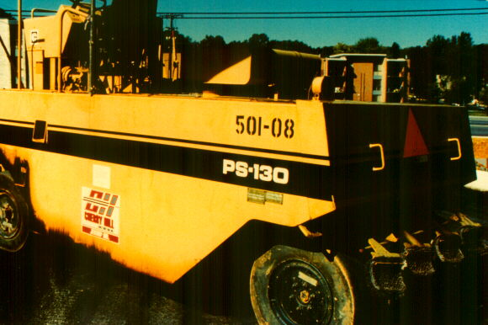
Pneumatic Roller
Notes:
Most pneumatic rollers are operated as intermediate rollers - behind a vibratory or static steel wheel breakdown roller and in front of a static wheel finish roller.
The compactive force is a function of the wheel load of the machine, the tire pressure, the tire design and the depth of penetration of the tires into the mix.
The tire pressures range from 60 to 120 psi and the minimum weight is 15 tons. For a tender mix a lower tire pressure should be used for an stiff mix a higher tire pressure should be used.

Slide 49
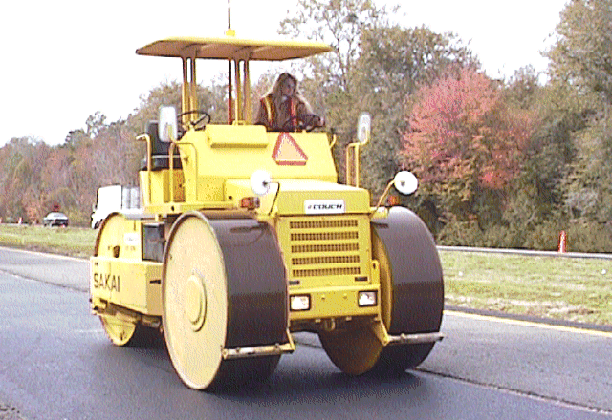
Steel Wheeled Roller
Notes:
Steel wheel rollers range from 3 to 14 tons. They can either be three wheel like this one or tandem.

Slide 50
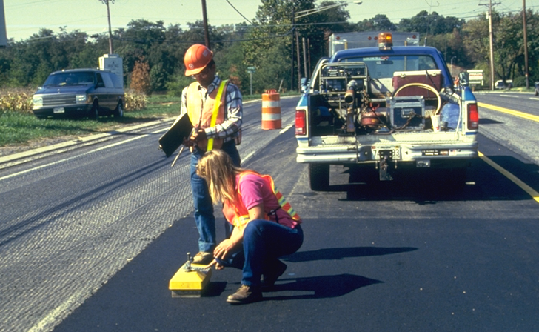
Checking Density With Nuclear Gauge
Notes:
The density can be checked using a nuclear density gauge. It needs to be correlated to core samples. The results are affected by the thickness of the layer being tested and the properties of the underlying layer.

Slide 51
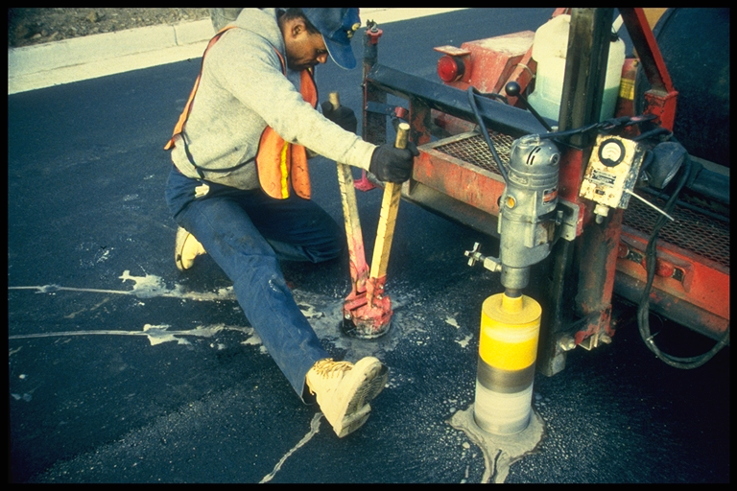
Extracting A Core
Notes:
Cores are taken for density determination and thickness. They are usually cut to obtain a sample of the layer being placed. The bulk specific gravity of the core is determined and using that with the maximum specific gravity it is possible to determine the percent compaction.

Slide 52
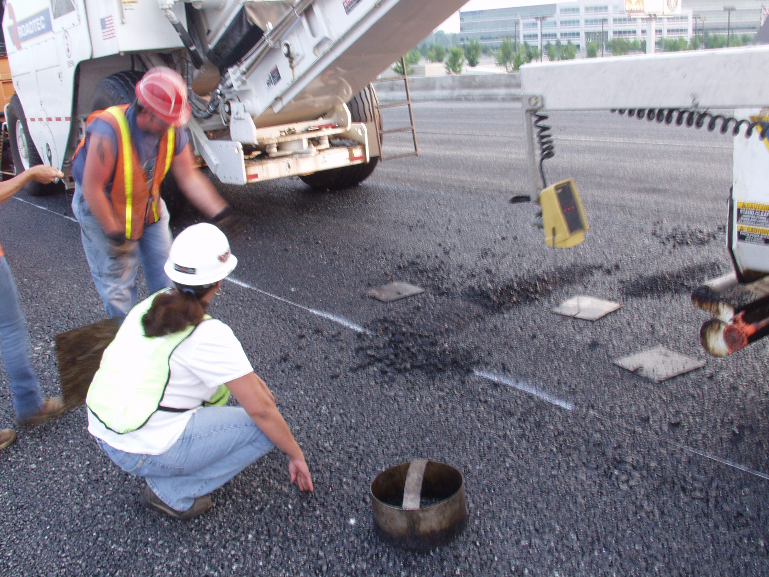

Slide 53
Questions - ?

