Slide 1
Asphalt Binder Changes in Indiana
June 2024

Slide 2
Outline
Introduction
Asphalt Mixtures
PG Binder Changes in Indiana
APAI’s Local Guidance Resources

Slide 3
Introduction
This presentation has been developed by the Asphalt Pavement Association of Indiana (APAI) to help provide background and express the impact of the new liquid asphalt binder changes across Indiana.
If there are questions regarding information in this presentation, please contact:
Elizabeth Pastuszka, Director of Technical Services with APAI
epastuszka@asphaltindiana.org
317.586.7280

Slide 4
Asphalt Mixtures

Slide 5

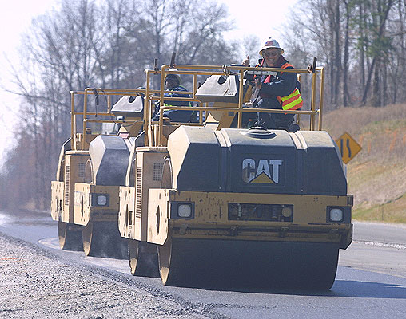

Asphalt Pavements are…
100% recyclable
Smooth and Quiet
Cost Effective
Quickly Constructed
Durable and Versatile

Slide 6
Recent Changes in asphalt pavement…
INDOT implementation of SP5 to increase in-place density by 1.5%
Partnering for PG binder specification changes with INDOT, APAI, Asphalt Mixture Producers, Asphalt Binder Refiners and Suppliers
Collaboration with INDOT Pavement Design to improve subgrade strength through trials on I-69 north of Pendleton.
Changes to INDOT pay factors to emphasize the effective asphalt content and capture the in-place specific gravity of the asphalt mixture.

Slide 7
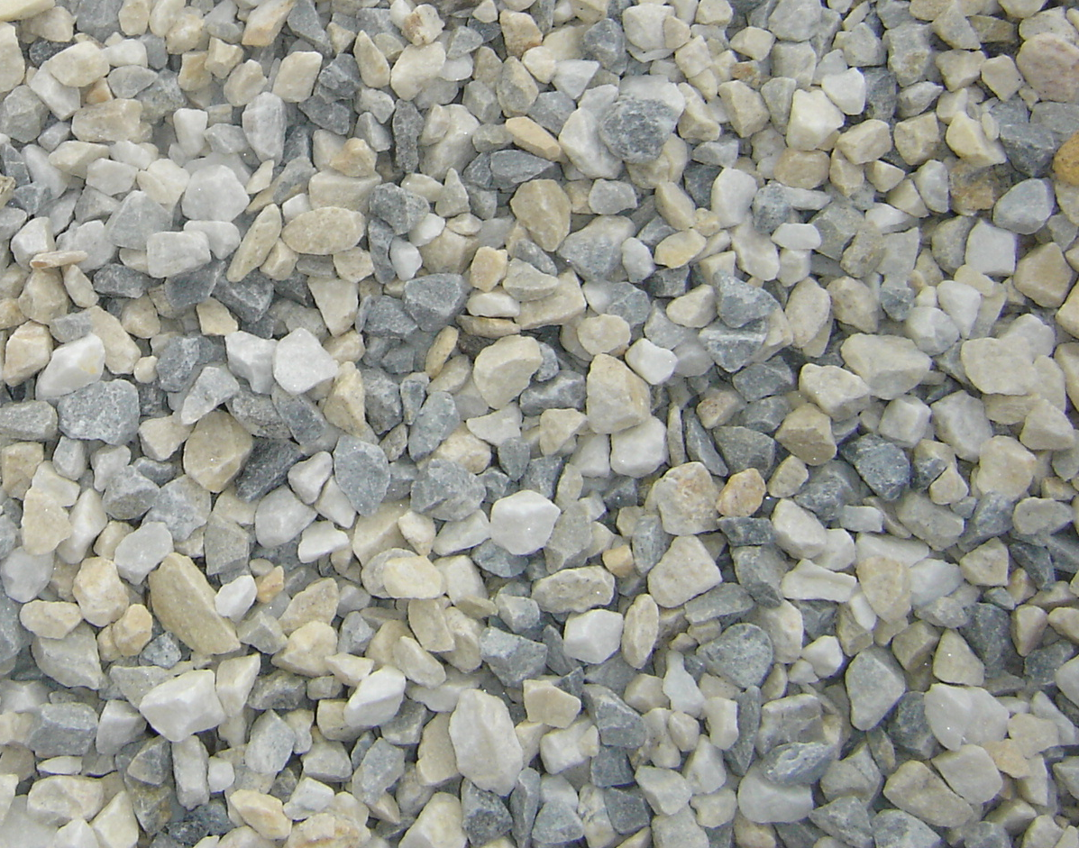
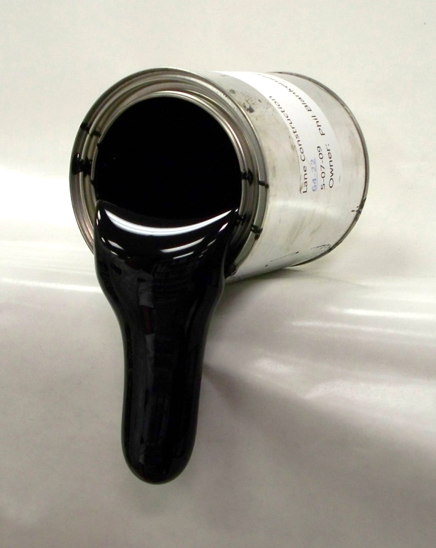

What is Asphalt?
Asphalt Mixtures are made of three components:
0% by Mass, 3-7% by Volume
Air
Liquid Asphalt Binder
4-6% by Mass, 11-12% by Volume
Aggregates
94-96% by Mass, 83-84% by Volume

Slide 8
Liquid Asphalt Binder
Asphalt Mixtures are made of three components:
0% by Mass, 3-7% by Volume
Air
Liquid Asphalt Binder
4-6% by Mass, 11-12% by Volume
Aggregates
94-96% by Mass, 83-84% by Volume

Slide 9
Asphalt Binder
Gasoline
Kerosine
Light Gas Oil
Heavy Gas Oil
Asphalt
Most asphalt today is obtained by vacuum distillation process that separates the low boiling point fraction from crude oil resulting in products with higher boiling points.
Asphalt is comprised of non-distillable fraction from crude oil refining.
Properties and quality of asphalt binder depend mainly on the crude source.
Asphalt is a black, thermoplastic, cementitious material whose viscosity changes in temperature.
At elevated temperatures, asphalt hardens to provide internal cohesion to the mixture and adhere to aggregate particles. This makes for waterproofing materials unaffected by most acids, alkalis, and salts.

Slide 10
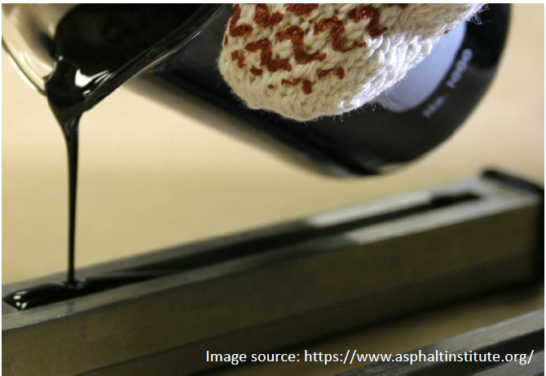
Asphalt Binder
Asphalt Behavior is dependent on:
Temperature
Time of Loading
Aging

Slide 11
Materials
asphalt binder nomenclature
147°F
-7°F
136°F
-18°F
PG 64-22
PG 58-28
Performance Grade
High Temperature ◦C
highest 7-day average pavement temperature
Low Temperature ◦C
lowest historical yearly pavement temperature

Slide 12
Materials
asphalt binder nomenclature
147°F
-7°F
136°F
-18°F
PG 64-22
PG 58-28
The HIGHER the high-grade temperature, the stiffer, more rut resistant the asphalt binder
The LOWER the low-grade temperature, the softer, more crack resistant the asphalt binder

Slide 13
Asphalt Binder Changes in Indiana

Slide 14
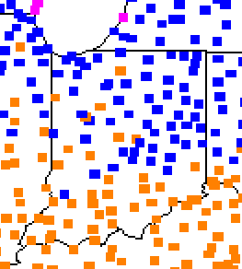
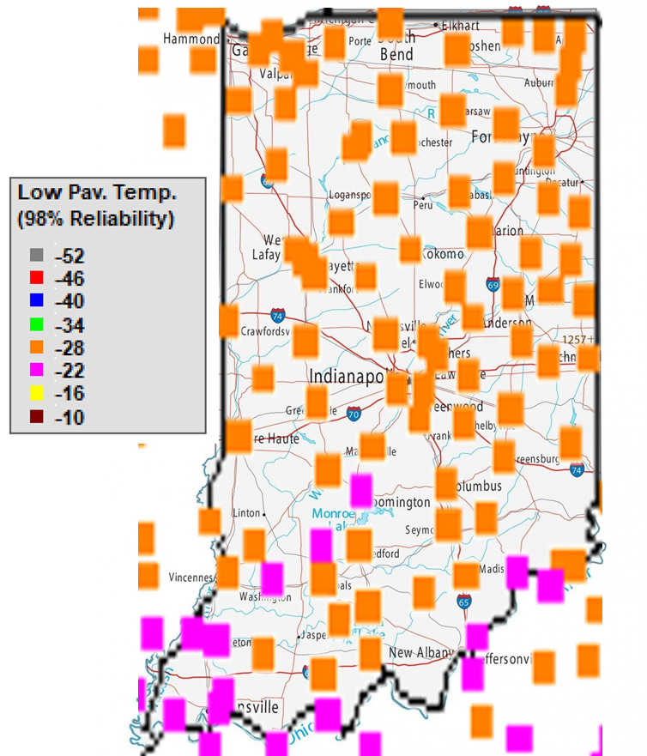
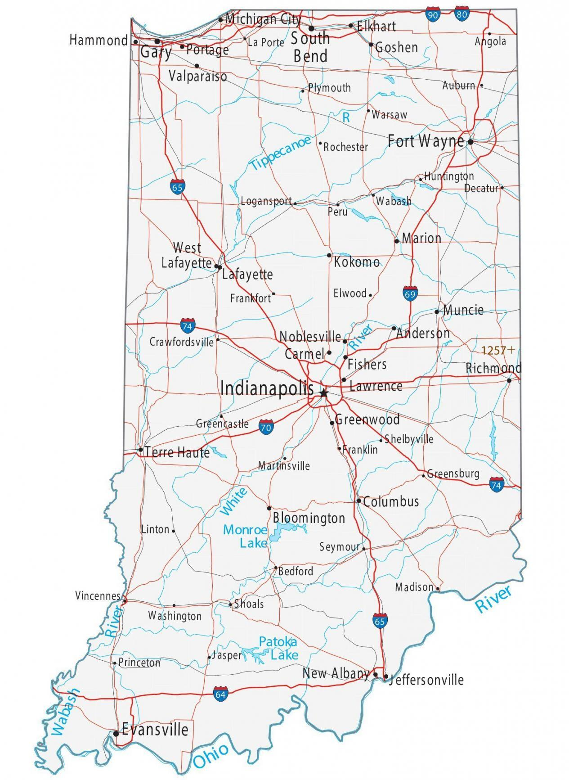
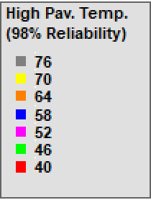
Materials
High Temperature
Low Temperature

Slide 15
Asphalt Binder
Performance graded testing (AASHTO M320)
  Developed as part of the Superpave mix design research to find tests for binders that better relate to field performance testing.
  Measures physical properties in terms of rutting, fatigue cracking and low temperature cracking
  Shortcoming for polymer modified asphalt (PMA) and limitations of the PG system to characterize PMA. Many agencies adopted tests to verify the presence of polymer and/or guarantee a minimum elastic response provide by polymer modifications. “PG-plus” test for elastic recovery, forced ductility, toughness and tenacity and phase angle tests.

Slide 16

Asphalt Binder
MSCR graded testing (AASHTO M 332)
  Multiple Stress Creek Recovery (MSCR) is the latest improvement to Superpave PG binder specifications. This test provides the user with a new high temperature component of the binder specification that more accurately indicates the rutting performance of the asphalt binder and is blind to modification.
  Evaluates the binder’s potential to permanent deformation.
  Uses higher stress and strains to capture the stiffening effect of the polymers and the delayed elastic effects.

Slide 17
Materials
Grade Bumping
Current asphalt binder PG based on testing at different high temperatures: 64°C, 70 °C, or 76 °C.
MSCR uses a change in non-recoverable creep compliance (Jnr) and tested at the same temperature, 58 °C, to allow for better evaluation at the expected operating temperature.

Slide 18
Materials
asphalt binder nomenclature
147°F
-7°F
136°F
-18°F
PG 64-22
PG 58S-28
Performance Grade
High Temperature ◦C
highest 7-day average pavement temperature
MSCR Traffic Designation
“S” = Standard
“H” = Heavy
“E” = Extremely Heavy
Low Temperature ◦C
lowest historical yearly pavement temperature
PG high temperature grade is based on climate, but due to heavy traffic, you would bump up the high grade for stiffer binder.
MSCR binders are stiffer with traffic designation change, not high temperature.

Slide 19
Asphalt Binder “Bumping”
PG testing and nomenclature
Current asphalt binder base grade PG 64-22
One binder “bump” PG 70-22
Two binder “bump” PG 76-22
MSCR testing and nomenclature
New asphalt binder base grade PG 58-28
Traffic levels designated by letters
Neat binder PG 58S-28
One binder “bump” PG 58H-28
Two binder “bump” PG 58E-28
Current PG Binder | New PG Binder | Traffic Designation
PG 64-22 | PG 58S-28 | S – Standard
PG 70-22 | PG 58H-28 | H – Heavy
PG 76-22 | PG 58E-28 | E – Extremely Heavy

Slide 20
Asphalt Binder Changes in Indiana
Why?
  To improve the durability and quality of asphalt pavements in Indiana
What?
  All asphalt base binders will change from PG 64-22 to PG 58-28
  All asphalt binder testing will change to MSCR AASHTO M332
When?
  INDOT contracts let on or after 9/1/2024 per RSP 400-R-780
  Contractors will have a chance to opt-in earlier with an upcoming Construction Memo TBD

Slide 21
Asphalt Binder Changes in Indiana
What to expect:
  Increase cost per ton. Will be different for binder grades and binder sources.
  New terminology for all asphalt binder material and mixture pay items. This will be reflected on:
    Contractor truck tickets and test results.
    Asphalt Binder Type A certifications from material refineries and terminals.
    Pay items for asphalt mixtures for pavement, patching, widening, tack coats, sealing or filling cracks and joints.
  Storage issues at the asphalt plants if local specifications do not coincide with the DOT changes.

Slide 22
What is Asphalt?
Asphalt Mixtures are made of three components:
0% by Mass, 3-7% by Volume
Air
Liquid Asphalt Binder
4-6% by Mass, 11-12% by Volume
Aggregates
94-96% by Mass, 83-84% by Volume

Slide 23
Materials
Aggregate use and type dependent on traffic level
Angularity
Texture
Shape

Slide 24
Aggregates
Consensus Properties
Coarse Aggregate Angularity
Fine Aggregate Angularity
Flat and Elongated
Clay Content
Source Properties
Toughness
Soundness
Deleterious
Absorption
Specific Gravity

Slide 25
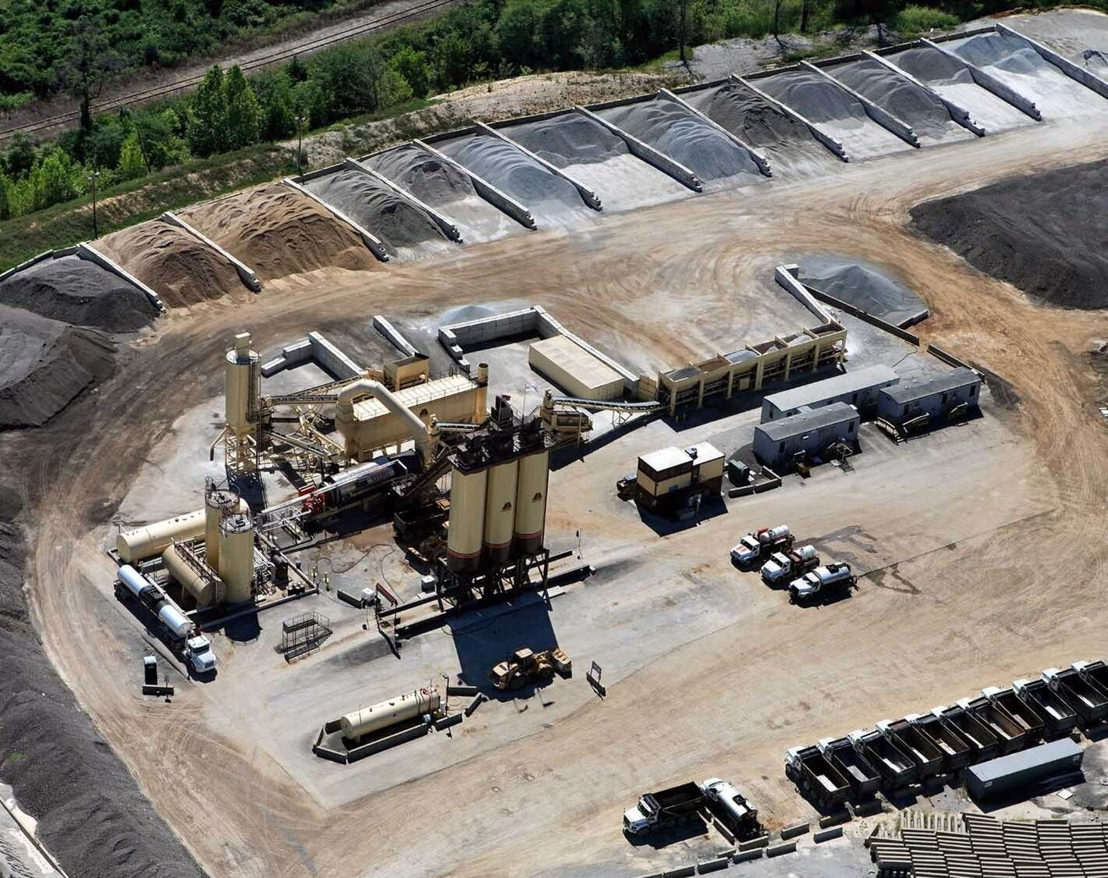
Aggregates
Use is driven by specification requirements
Size of mixture required
  Base mixes have larger maximum size
Look at local source availability and quality
  Can the quarry produce necessary materials?
  Will there be enough aggregates for the project?
Gradation requirements
Plant capabilities
  Number of aggregates in mix design need to be equal to or less than number of bins

Slide 26
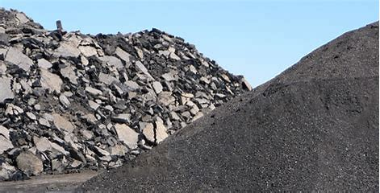
Recycled Materials
Asphalt Pavement is 100% Recyclable!
Reclaimed Asphalt Pavement (RAP)
  Produced from existing pavement
  Contains aggregates and asphalt binder
  Set aside and treated like an aggregate at the plant
Reclaimed Asphalt Shingles (RAS)
  High percent of asphalt binder but very stiff (PG 142 or higher)
  Limited on use because of stiffness
Other Recycled materials used in asphalt mixes may include ground tire rubber, fibers, glass, plastics, bio oils
When using recycled products, the mix design should be engineered to meet quality and durability in addition to specification requirements.

Slide 27
Recycled Materials - Nationally
“the performance of pavements containing up to 30% RAP is similar to that of pavements constructed from virgin materials with no RAP.” (Copeland, 2011)
When RAP is added responsibly, performance of mixtures containing RAP can be equivalent to virgin mixtures

Slide 28
Recycled Materials
If an asphalt mix contains 21.1% RAP, the average cost savings is $7.80/ton of mix (NAPA, 2020)
This savings translates to 12.5% more lane-miles of paving when virgin mix can cost $70/ton.
With a $1,000,000 budget, 2.6 additional lane-miles can be paved at 1.5” deep
Increasing RAP in new mixtures by 1% would reduce emissions (CO2e)equivalent to 30,000 passenger vehicles (U.S. EPA, 2018)

Slide 29
Recycled Materials – INDOT specifications
Recycled materials may be used as a substitute for a portion of the new materials require to produce HMA mixtures.
May consist of RAP or RAS or blend of both.
RAP shall be processed so that 100% will pass the 2” sieve and RAP coarse aggregate shall pass the maximum size sieve for the mixture being produced.
RAS may be obtained from either pre-consumer or post-consumer asphalt shingles. Two RAS types cannot be blended together.
The recycled percentages shall be specified on the DMF.
INDOT allows a maximum of 25.0% binder replacement in all HMA mixtures. RAS shall be ≤ 3.0% by total mass and ≤ 15.0% binder replacement.

Slide 30
Recycled Materials
RAP is a valuable resource when used responsibly
  Increase virgin asphalt binder and/or use a softer asphalt binder
  Balanced Mix Design testing
  Use of additive
AASHTO M 323-22

Slide 31
APAI’s Resources

Slide 32
Liquid Asphalt Binder Changes
Liquid Asphalt Binder Changes One-Pager
Liquid Asphalt Binder Changes Carrying Card
Liquid Asphalt Binder Changes PowerPoint Presentation
APAI Local Guide Specification
INDOT Links
  Recurring Special Provisions with new binder verbiage
  Design Memo No. 23-21
  Construction Memo No. 24-08
WE DO LUNCH AND LEARNS/WORKSHOPS!!

Slide 33
Local Guidance Documents
Documents on APAI’s website:
  Asphalt Pavement Guidance Specification for Local Agencies
  Bid From Template
  Sample Advertisements for Bids
  Sample Award Document
  Contract Template
Checklists on APAI’s website:
  Design Mix Formula
  Field Inspector Checklist
  Plant and Lab Visit Checklist

Slide 34
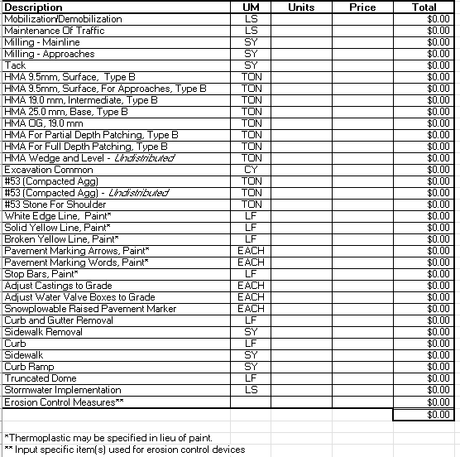
APAI Local Guidance Resources
Bid Form Template for Local Governments and Non-Governmental Asphalt Paving Applications
Excel File with list of asphalt paving and materials related to asphalt pavements

Slide 35
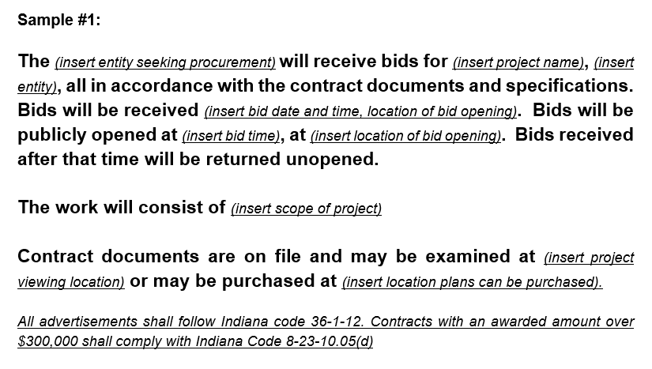
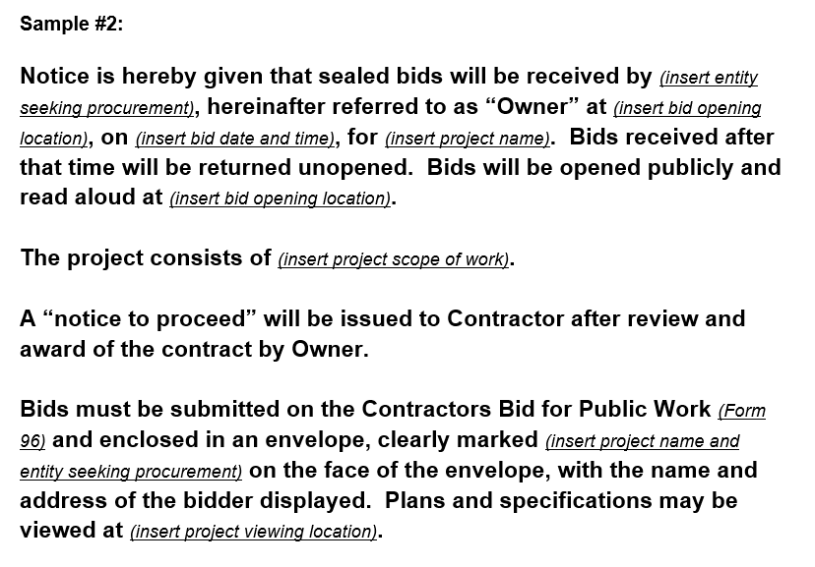
APAI Local Guidance Resources
Sample Advertisement for Bids
Two examples, editable for specific project

Slide 36
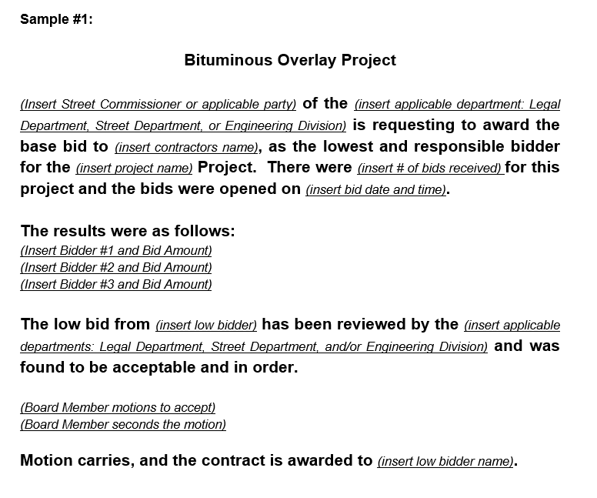
APAI Local Guidance Resources
Sample Award Document
Award documentation example completely editable for a specific project

Slide 37
APAI Local Guidance Resources
Contract Template
Sample agreement with guidance language between owner and Contractor that is editable for a specific project and outlines articles for:
Work
The Project
Contract Price
Payment Procedures
Contract Documents
Employee Eligibility Verification
Safety

Slide 38
APAI Local Guidance Resources
Asphalt Pavement Guidance Specification for Local Agencies
Outlines Design and Construction Guidance as well as local specification recommendations.

Slide 39
Guidance Specification for Local Governments
Design Guidance and Construction Guidance
Mixture Size Designation | Minimum Lift Thickness, in. | Maximum Lift Thickness, in. | Target HMA Layer Thickness, in.
9.5 mm | 1.0 | 2.5 | 1.5 or 2.0
12.5 mm | 1.5 | 3.75 | 2.5 – 3.0
19.0 mm | 2.0 | 5.0 | 2.5 – 4.0
25.0 mm | 3.0 | 7.5 | 4.5 – 6.0
Design Guidance
  Conversions
  Lift Thicknesses
  Materials
  Mixture criteria for given traffic conditions, includes PG 58-28 and new binder terminology
Mixture Type |  | Type B | Type C
Design ESAL |  | <3,000,000 | ≥3,000,000
AADT (Average Annual Daily Traffic) |  | <15,000 | 15,000 - 30,000
AADTT (Average Annual Daily Truck Traffic)* |  | <1700 | ≥1700
Surface** | Mixture Size Designation | 9.5 mm 12.5 mm | 9.5 mm 12.5 mm
 | Recommended PG Binder | 58S-28 | 58H-28
Intermediate | Mixture Size Designation | 12.5 mm 19.0 mm | 12.5 mm 19.0 mm
 | Recommended PG Binder | 58S-28 | 58H-28
Base | Mixture Size Designation | 19.0 mm 25.0 mm | 19.0 mm 25.0 mm
 | Recommended PG Binder | 58S-28 | 58S-28
Note: If a pay item is designated as a PG 58S-28 and a surface mixture has less than or equal to 15.0% binder replacement, the binder grade shall be 58H-28.

Slide 40
Design Best Practices
Align with Indiana Design Guide for lift thicknesses
Mix design follows INDOT Standard Specification section 401.05 requirements
If follow APAI guidance, mix design will come from INDOT qualified mis design laboratory and produced from an INDOT certified plant.
Mixture designations correlate to ESALs and INDOT Standard Specifications section 402
Recycled maximum in INDOT specification 25% binder replacement

Slide 41
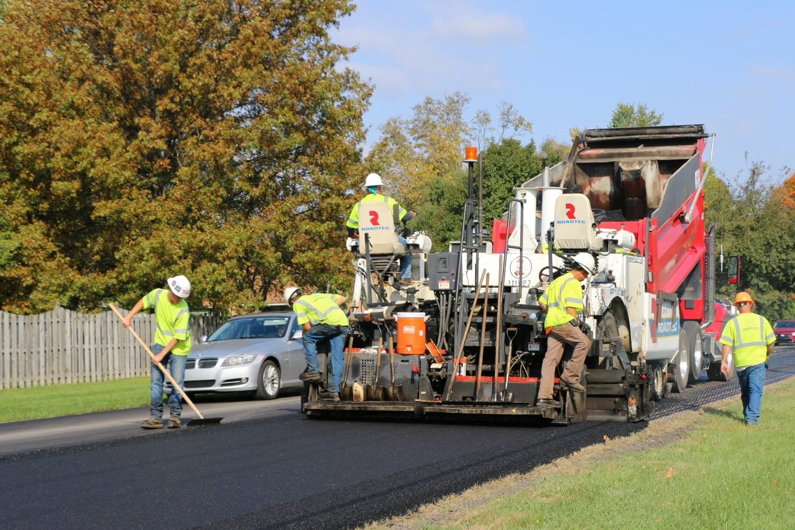
Guidance Specification for Local Governments
Design Guidance and Construction Guidance
Construction Guidance
  Subgrade, Subbase, Milling and Surface Preparation
  Tack Coat
  Asphalt Mixture Placement
  Compaction
  Weather Limitations
  Asphalt Mixture Acceptance

Slide 42
Asphalt Overlay Surface Preparation
Surface Preparation for an asphalt overlay may include one or more of the following:
Patching
Cleaning and sealing cracks
Placing a wedge or leveling course
Milling
Failed areas must be repaired and brought to good structural condition before overlaying.

Slide 43
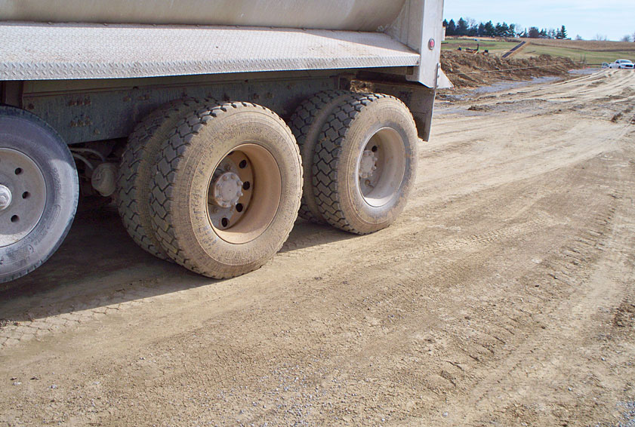
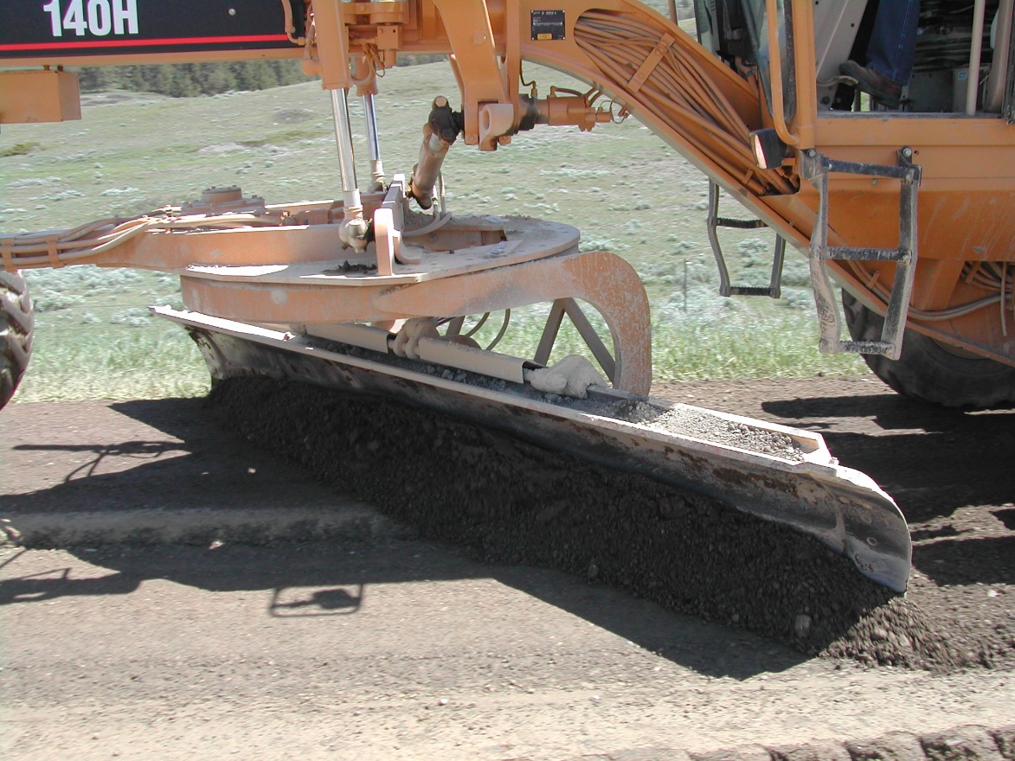
Construction Best Practices
Subgrade and Subbase
Subgrade is pavement foundation
Subgrade uniformly compacted
  Proof roll for stability or soft spots
Properly graded for drainage
  Transverse and longitudinal grade
  Smoothness and cross slope
Aggregate subbase properly compacted to percentage or proctor specified

Slide 44
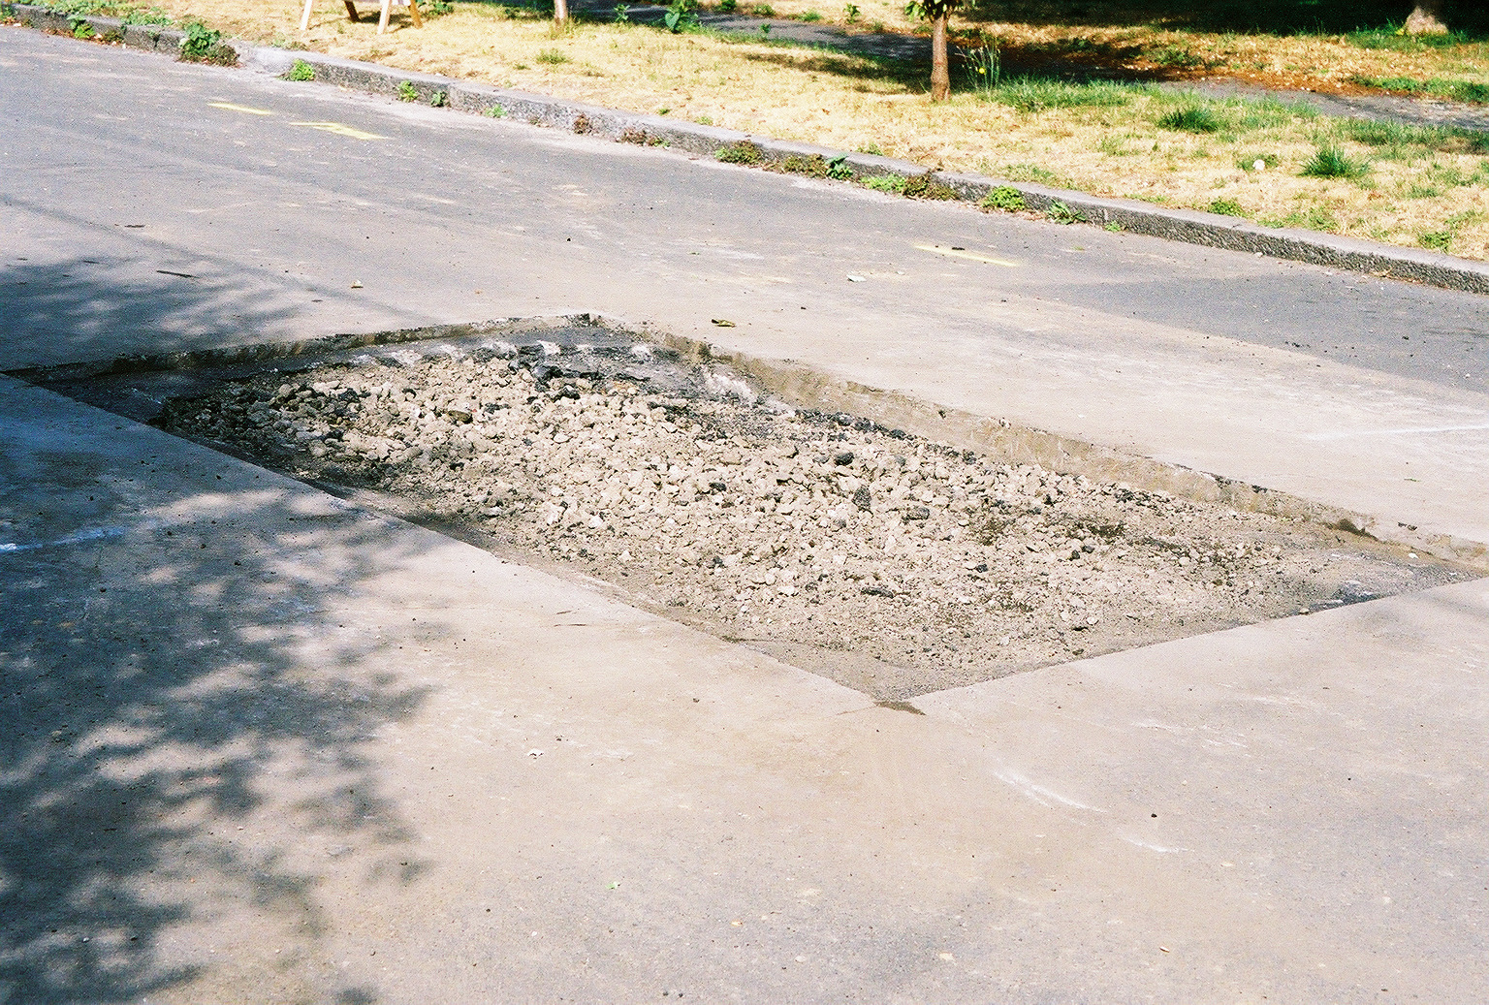
Construction Best Practices
Patching
Remove the material to be repaired until firm support is reached.
Excavation should extend at least 1-foot into the good pavement.
Clean the vertical faces and apply a tack coat.
For deep patches, apply a tack coat at the bottom of the horizontal face.

Slide 45
Construction Best Practices
Patching
Fill the patch with asphalt mixture of the same type specified.
Compact the patch thoroughly, flush with the surrounding pavement.
  Use vibrating plate for small patches or roller for large patches
  Compact corners
Make sure patches have straight lines with no distresses outside of the patch.
Check with a straightedge to make sure the patch is even.

Slide 46
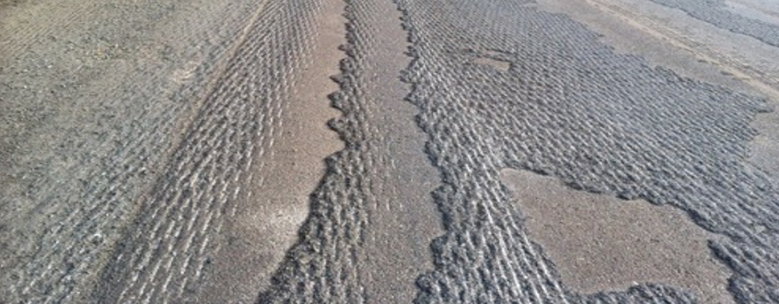
Construction Best Practices
Milling
Remove distressed pavement (rutting, top-down cracking)
Opportunity to improve cross slope
Creates RAP
Provides texturized surface for overlay
Don’t leave “scabs” of asphalt and avoid milling too deep

Slide 47
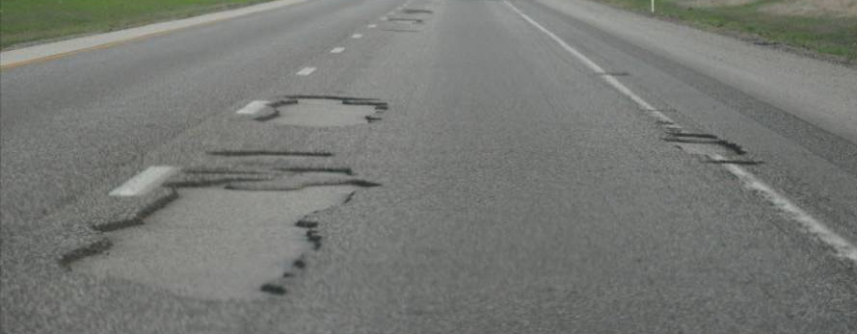
Construction Best Practices
Tack Coat
Free of foreign debris
No standing water on pavement
Apply uniformly across lane width
No streaking or ponding
Minimum 95% coverage
Sufficient time to break and set to minimize tracking
Correct areas of inadequate or excessive coverage

Slide 48
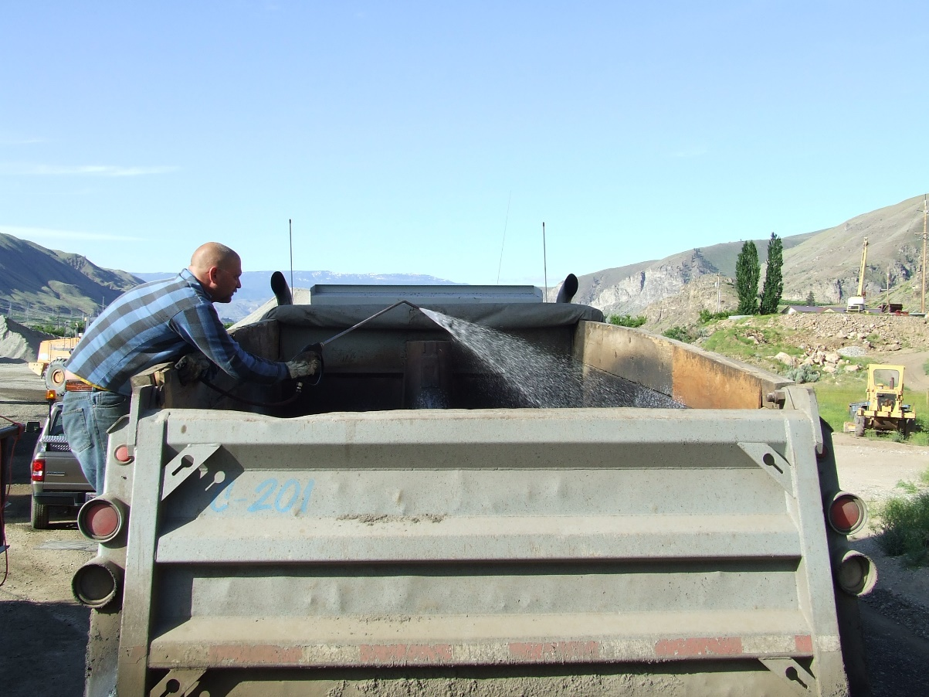
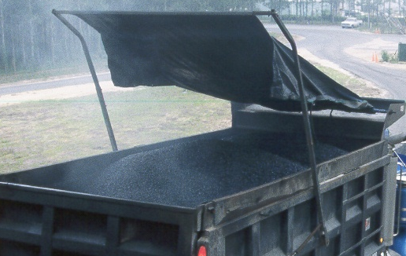
Construction Best Practices
Transportation
Adequate number of trucks for continuous paving
Proper loading from the plant to prevent segregation
Asphalt mix delivered at the proper temperature
Cover truck beds with tarp to prevent mix from cooling
Use of anti-adhesive material from INDOT QPL on truck beds.
DIESEL FUEL

Slide 49
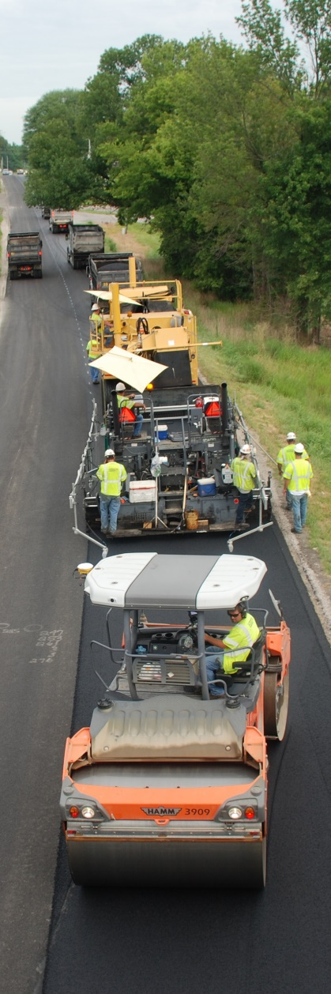
Construction Best Practices
Production
Weather limitations for ambient temperatures based on depth of asphalt course
Appropriate paver speed for balanced operation
  Producing Transporting Paving Compacting
Minimize segregation
Smooth finished mat
Proper compaction is achieved
Finished lift thickness is obtained

Slide 50
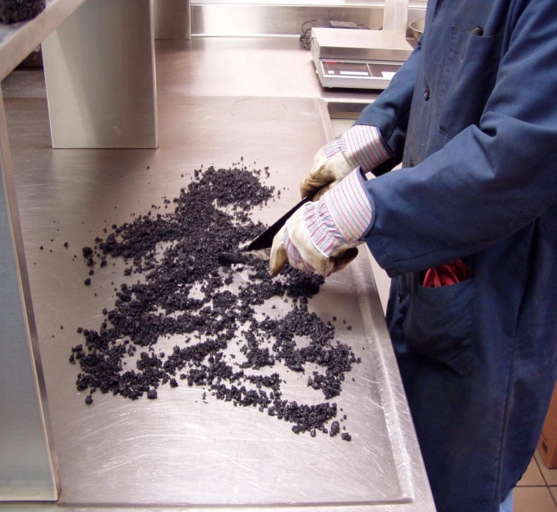
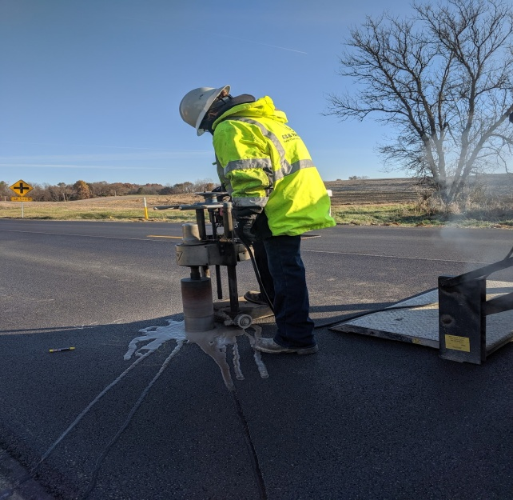
Quality Assurance
Quality Assurance for local agencies
Guidance to follow INDOT Standard Specification section 402
  Type D certification requirements
Require submittal of asphalt mix designs and review
Other QA requirements like density/cores?
Inform and train field inspectors. Daily checklist?
Communicate with Contractor before, during, and after production

Slide 51
APAI Online Resources
Liquid Asphalt Binder Changes Resources on APAI’s website
Local Agency Resources on APAI’s website

Slide 52


Visit APAI’s website for resource documents and more information!
Questions? Contact Elizabeth Pastuszka with APAI
epastuszka@asphaltindiana.org
317.586.7280

